Slide 1
P&C (Re)Insurer’s Share Buyback ROI
2013 – 2017

Slide 2
P&C (Re)Insurer’s Share Buyback ROI
Goal
The goal of this analysis is to calculate the historical return on investment (ROI) of share buybacks for P&C (re)insurance companies over the past 20 quarters (2013 - 2017). This is one way to measure whether companies have effectively allocated their capital to share buybacks. We split the buyback ROI into two components – overall buyback ROI and buyback effectiveness - to understand how well a company has timed their share repurchases.
The methodology used is inherently backwards looking and answers the question:
Based on what we know now (i.e. a company's stock price over the period), did the company achieve a reasonable return on their cash spent buying back shares?
Methodology
The buyback ROI is calculated based on three items:
The cash outflows associated with share repurchases each quarter
The implied cash inflows of dividends (common and special) "avoided" by repurchasing shares
A final cash inflow related to the total value of the cumulative shares repurchased
Given this set of cash flows, we then calculate the annualized internal rate of return to give us the buyback ROI.
An additional metric to calculate is the "buyback effectiveness" return. This metric isolates the impact of management timing in repurchasing shares by backing out the total shareholder return over the time period from the buyback ROI. Buyback effectiveness equals one plus buyback ROI divided one plus total shareholder return (minus one). This metric highlights companies that successfully buyback more shares right before their stock price increases and buy less before their stock decreases.

Slide 3
P&C (Re)Insurer’s Share Buyback ROI
Data used
The data used for this analysis is from SEC Forms 10-Q and 10-K for each company over the time period of 2013 - 2017 on a quarterly basis, per S&P Global Market Intelligence.
Number of shares repurchased in the quarter
Average price per share for shares repurchased
Common shares outstanding
Common dividend per share
Special dividend per share
Book value per share
Additionally, historical share price data was downloaded from Yahoo Finance.

Slide 4
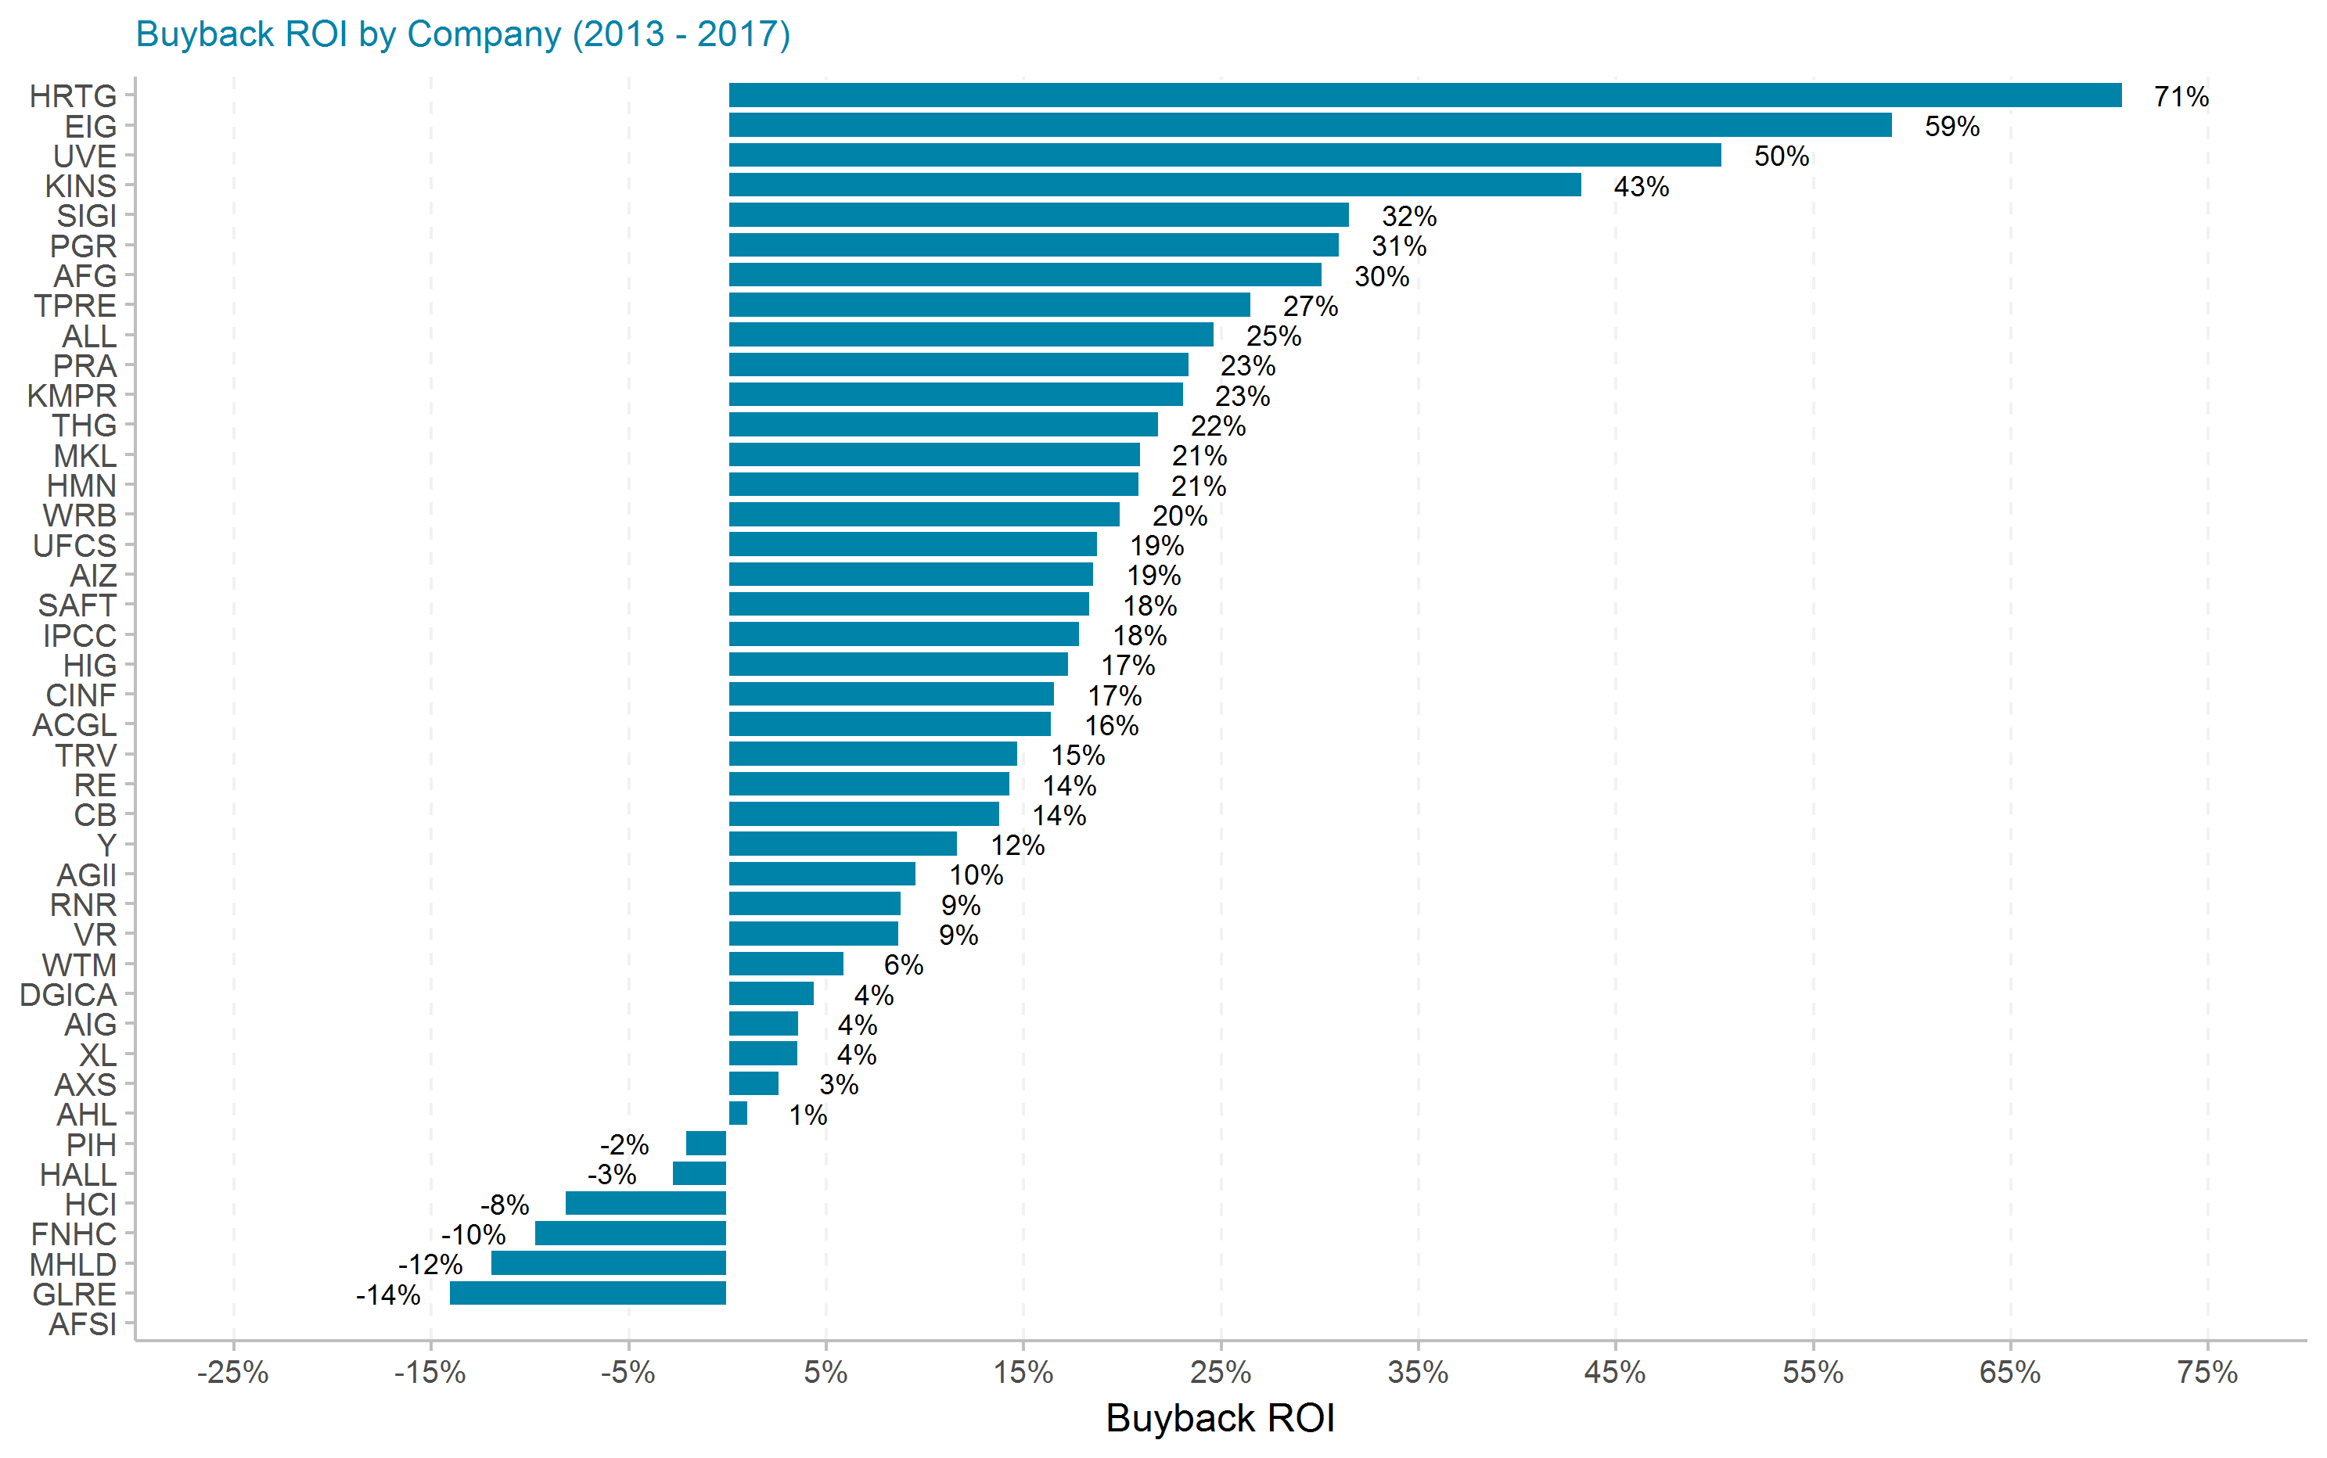
Buyback ROI by Company

Slide 5
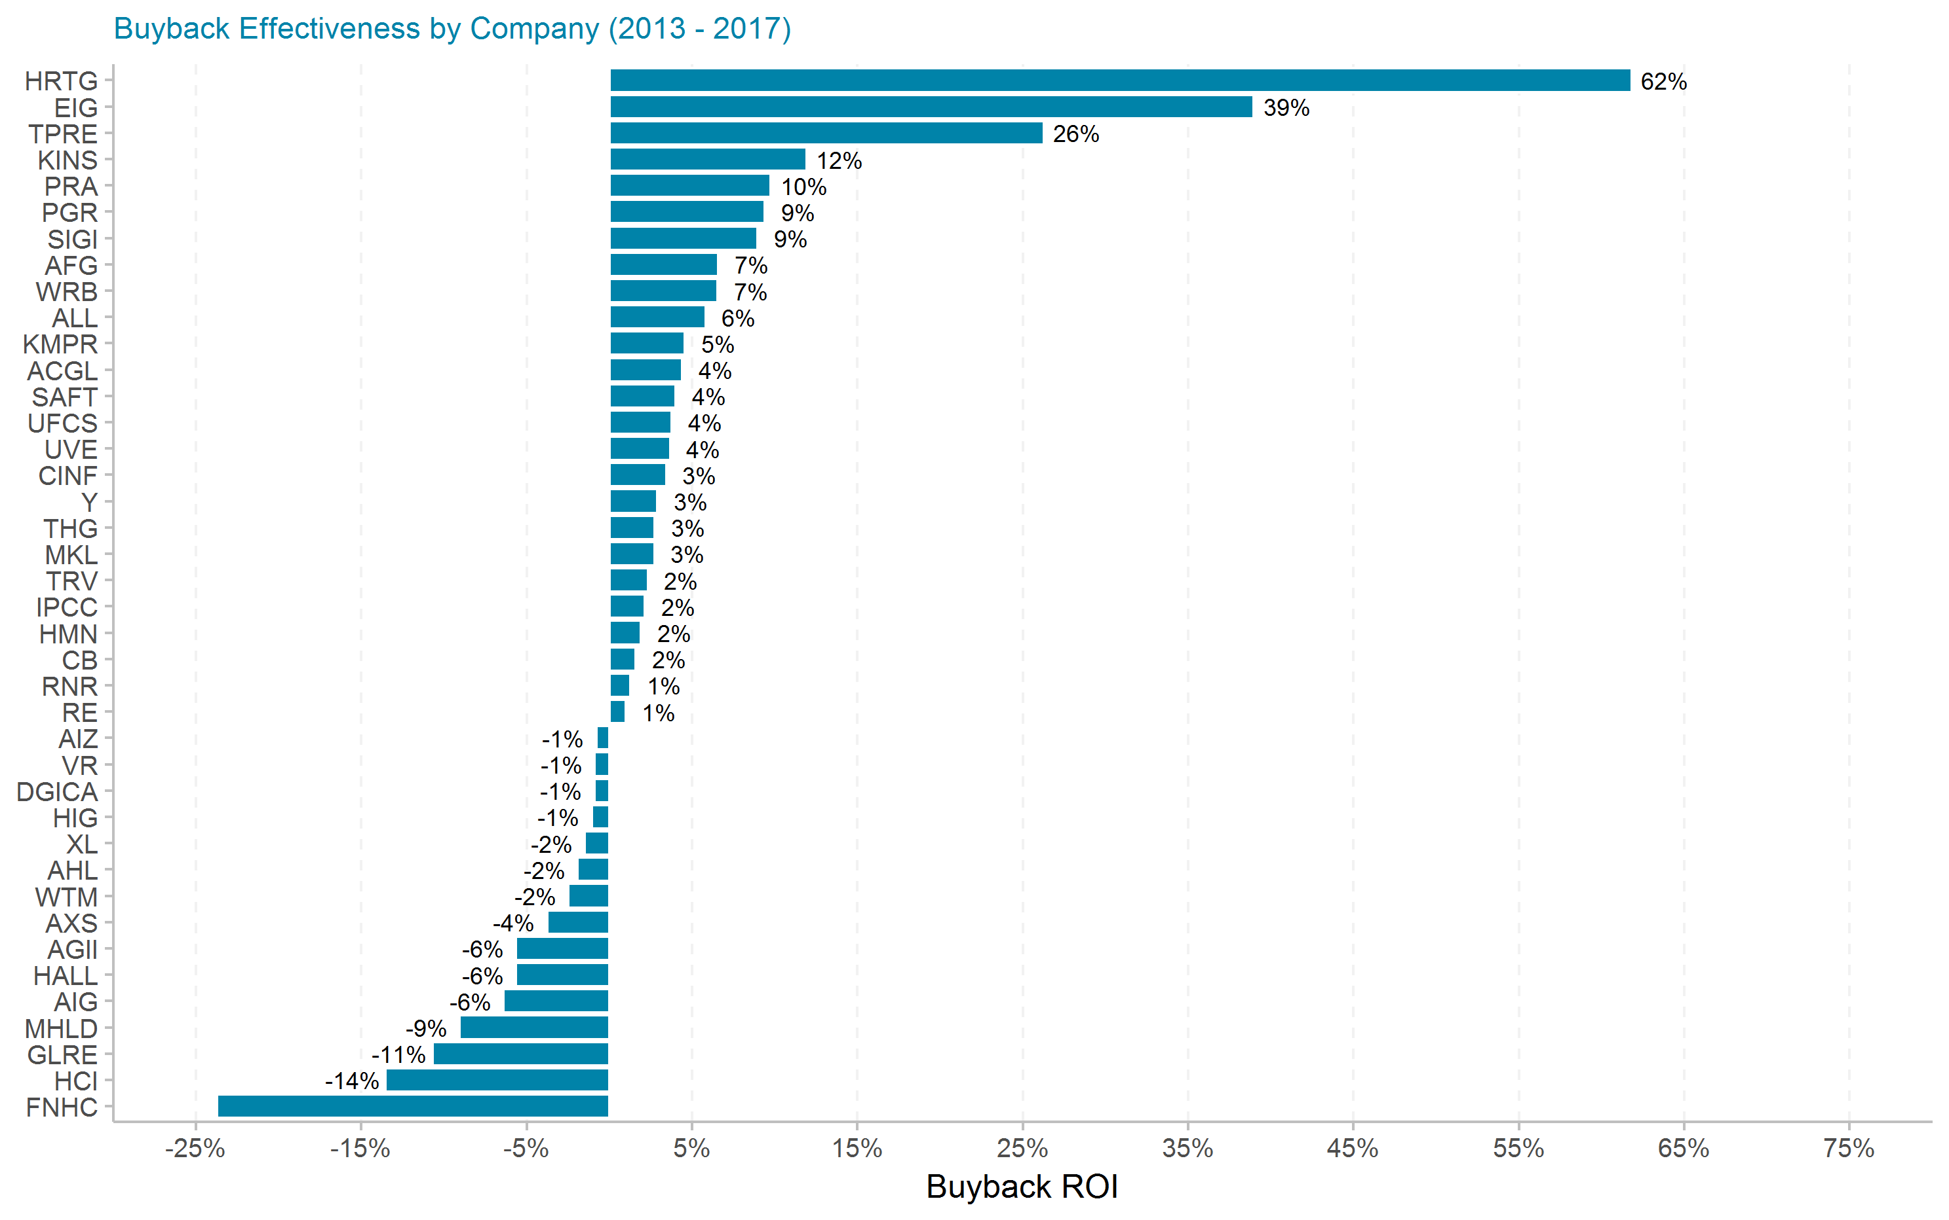
Buyback Effectiveness by Company

Slide 6
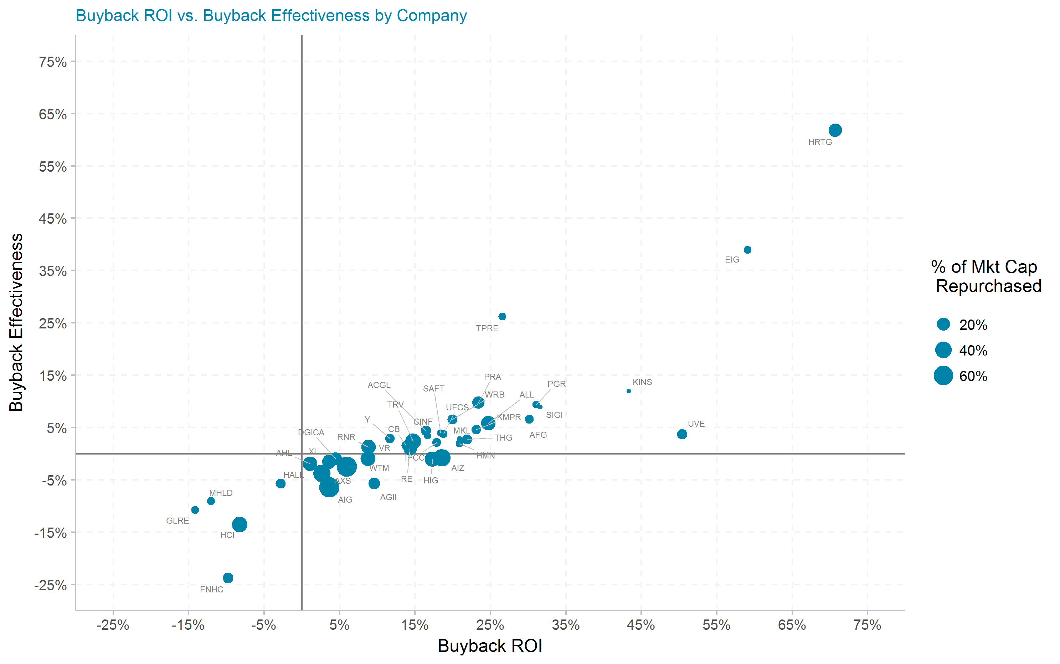
Buyback ROI vs. Buyback Effectiveness by Company

Slide 7
Top 25 most effective share repurchasers
Top 25 most effective share repurchasers
Ticker | # of quarters | Current Mkt Cap ($m) | Initial Shares (mil) | Shares Repurchased (mil) | Dollar Repurchased ($m) | Percent of Initial Shares Repurchased | Percent of Mkt Cap Repurchased | Total Shareholder Return | Buyback ROI | Buyback Effectiveness
HRTG | 15 | 417 | 29.8 | 7.1 | 88 | 23.8% | 21.1% | 5.5% | 70.7% | 61.8%
EIG | 20 | 1,340 | 30.9 | 1.4 | 42 | 4.7% | 3.1% | 14.5% | 59.1% | 39.0%
TPRE | 18 | 1,380 | 103.9 | 3.9 | 48 | 3.8% | 3.5% | 0.2% | 26.6% | 26.3%
KINS | 20 | 183 | 3.8 | 0.1 | 1 | 3.5% | 0.6% | 28.1% | 43.3% | 11.9%
PRA | 20 | 2,530 | 61.8 | 9.3 | 426 | 15.1% | 16.9% | 12.4% | 23.4% | 9.8%
PGR | 20 | 35,110 | 603.2 | 37.0 | 1,008 | 6.1% | 2.9% | 19.8% | 31.0% | 9.4%
SIGI | 20 | 3,480 | 55.5 | 0.8 | 22 | 1.4% | 0.6% | 20.7% | 31.5% | 9.0%
AFG | 20 | 10,060 | 89.9 | 8.8 | 534 | 9.8% | 5.3% | 22.1% | 30.2% | 6.6%
WRB | 20 | 9,420 | 136.0 | 17.4 | 809 | 12.8% | 8.6% | 12.6% | 19.9% | 6.6%
ALL | 20 | 34,540 | 468.0 | 157.4 | 9,313 | 33.6% | 27.0% | 17.9% | 24.7% | 5.8%
KMPR | 20 | 3,480 | 58.3 | 7.7 | 269 | 13.2% | 7.7% | 17.8% | 23.1% | 4.6%
ACGL | 20 | 10,950 | 133.1 | 17.9 | 1,052 | 13.5% | 9.6% | 11.5% | 16.5% | 4.4%
SAFT | 20 | 1,220 | 15.4 | 0.6 | 28 | 3.6% | 2.3% | 13.8% | 18.4% | 4.0%
UFCS | 20 | 1,250 | 25.3 | 1.4 | 51 | 5.5% | 4.0% | 14.5% | 18.8% | 3.8%
UVE | 20 | 1,140 | 40.7 | 12.4 | 113 | 30.5% | 9.9% | 45.1% | 50.4% | 3.7%
CINF | 20 | 11,550 | 163.0 | 4.9 | 285 | 3.0% | 2.5% | 12.8% | 16.6% | 3.4%
Y | 20 | 8,850 | 16.8 | 1.5 | 669 | 9.2% | 7.6% | 8.5% | 11.7% | 2.9%
THG | 20 | 4,890 | 44.0 | 6.2 | 428 | 14.0% | 8.8% | 18.6% | 21.9% | 2.7%
MKL | 20 | 15,700 | 9.6 | 0.3 | 199 | 2.7% | 1.3% | 17.7% | 21.0% | 2.7%
TRV | 20 | 35,570 | 376.4 | 128.6 | 12,929 | 34.2% | 36.3% | 12.1% | 14.8% | 2.3%
IPCC | 20 | 1,440 | 11.6 | 1.0 | 79 | 9.0% | 5.5% | 15.4% | 17.9% | 2.1%
HMN | 20 | 1,830 | 39.7 | 1.8 | 54 | 4.5% | 3.0% | 18.6% | 20.9% | 1.9%
CB | 20 | 63,200 | 340.0 | 34.1 | 3,800 | 10.0% | 6.0% | 12.0% | 13.8% | 1.6%
RNR | 20 | 5,450 | 44.5 | 14.7 | 1,521 | 33.0% | 27.9% | 7.5% | 8.9% | 1.3%
RE | 20 | 9,530 | 50.0 | 12.8 | 2,008 | 25.6% | 21.1% | 13.2% | 14.3% | 1.0%

Slide 8
By Company Detail

Slide 9
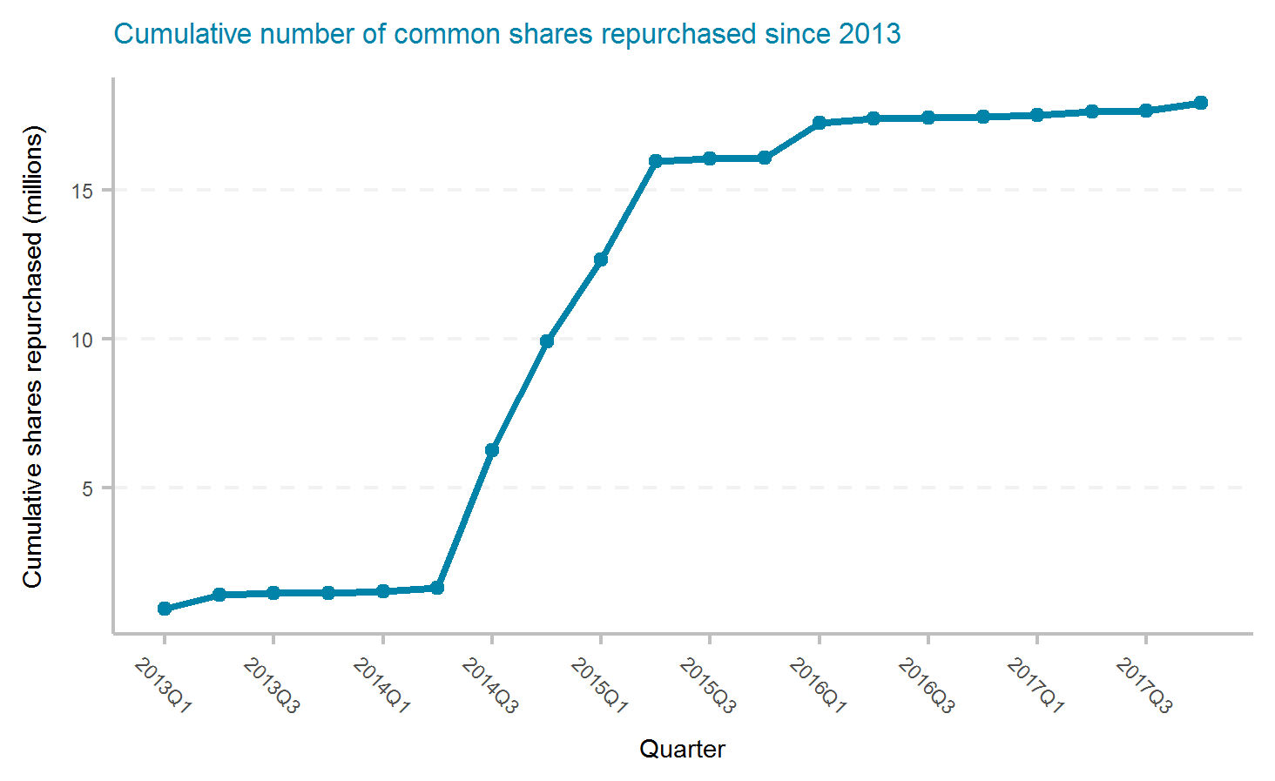
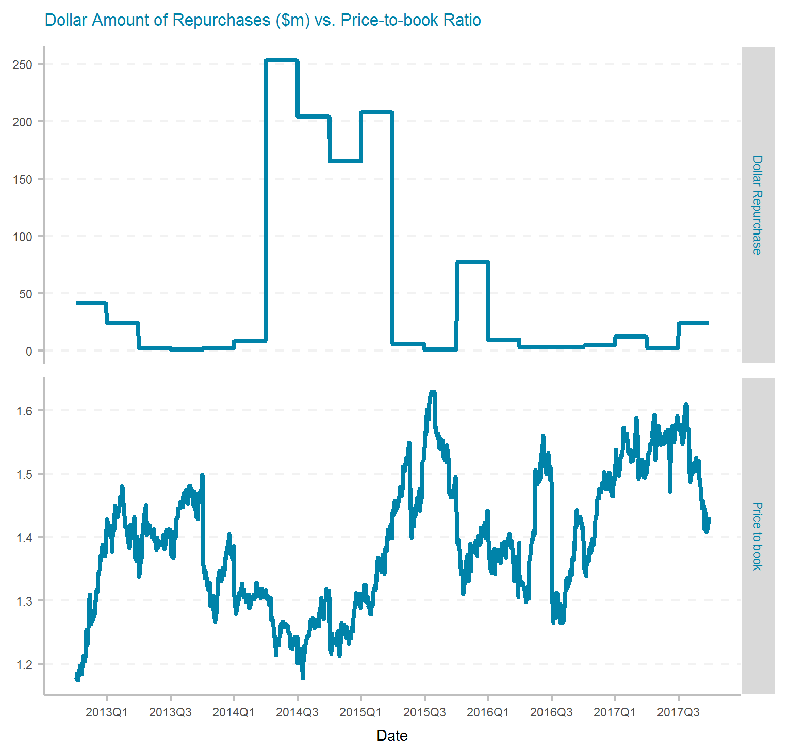
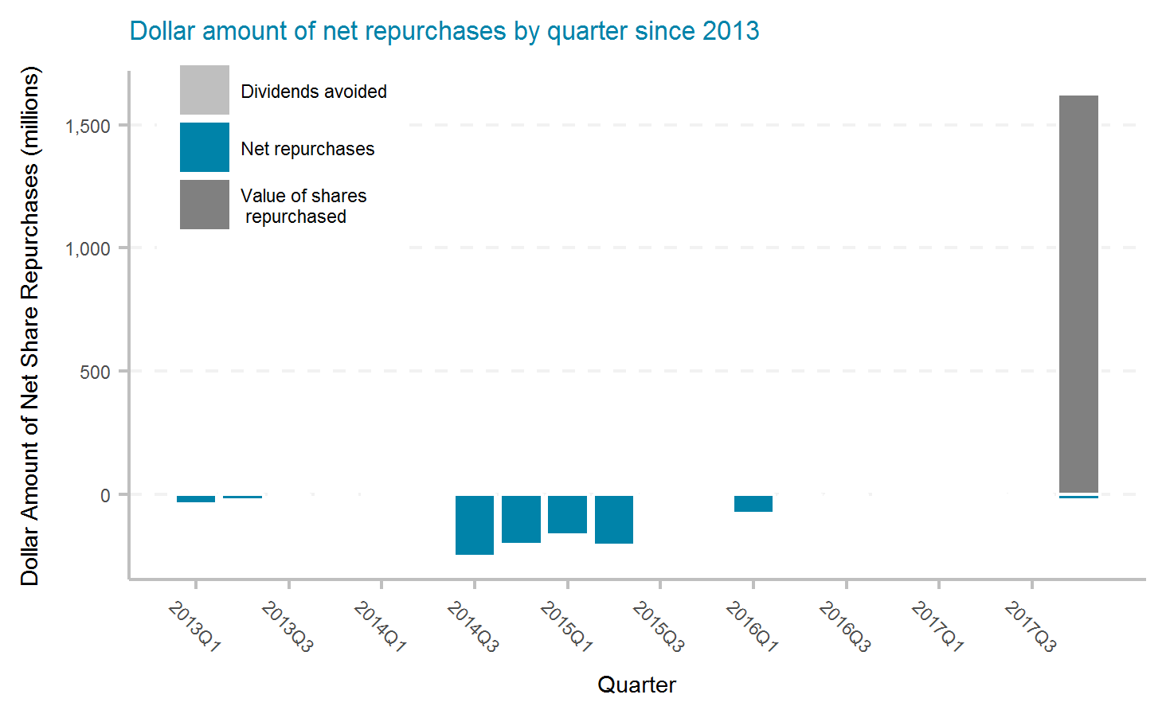
Arch Capital Group Ltd.
Ticker | # of quarters | Current Mkt Cap ($m) | Initial Shares (mil) | Shares Repurchased (mil) | Dollar Repurchased ($m) | Percent of Initial Shares Repurchased | Percent of Mkt Cap Repurchased | Total Shareholder Return | Buyback ROI | Buyback Effectiveness
ACGL | 20 | 10,950 | 133.1 | 17.9 | 1,052 | 13.5% | 9.6% | 11.5% | 16.5% | 4.4%

Slide 10
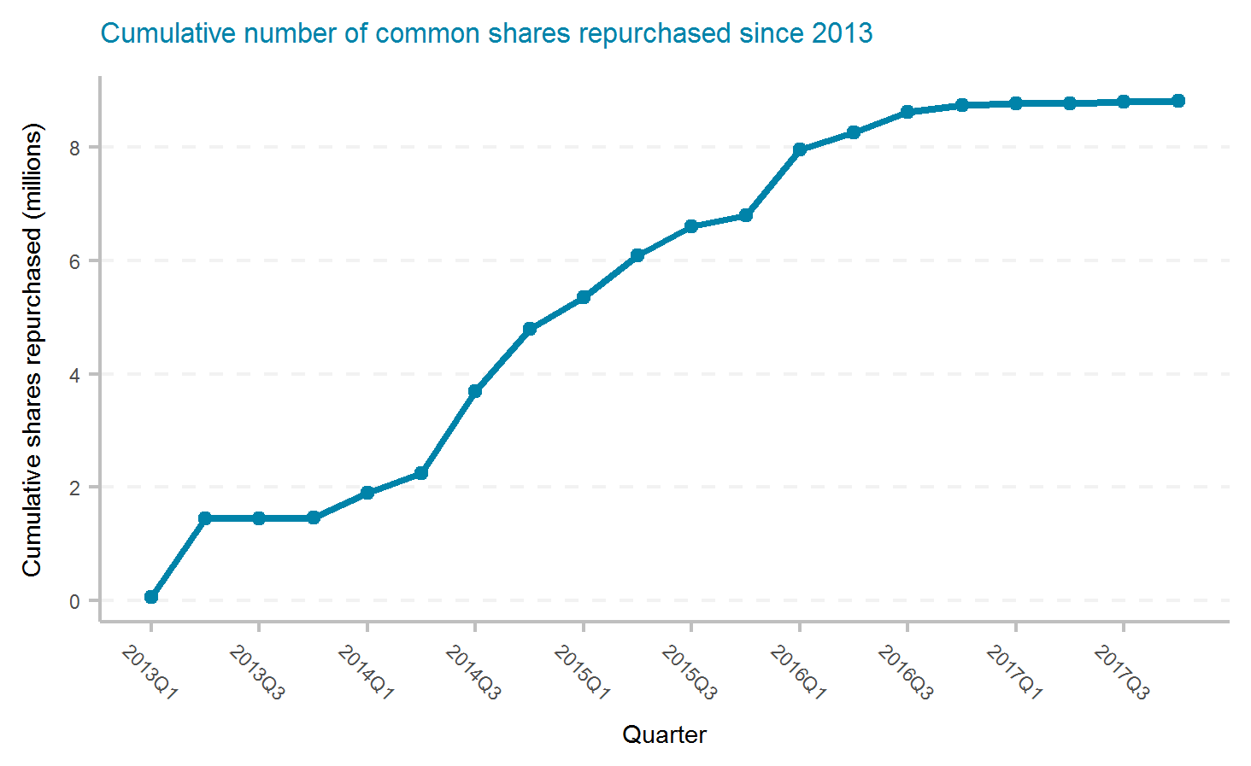
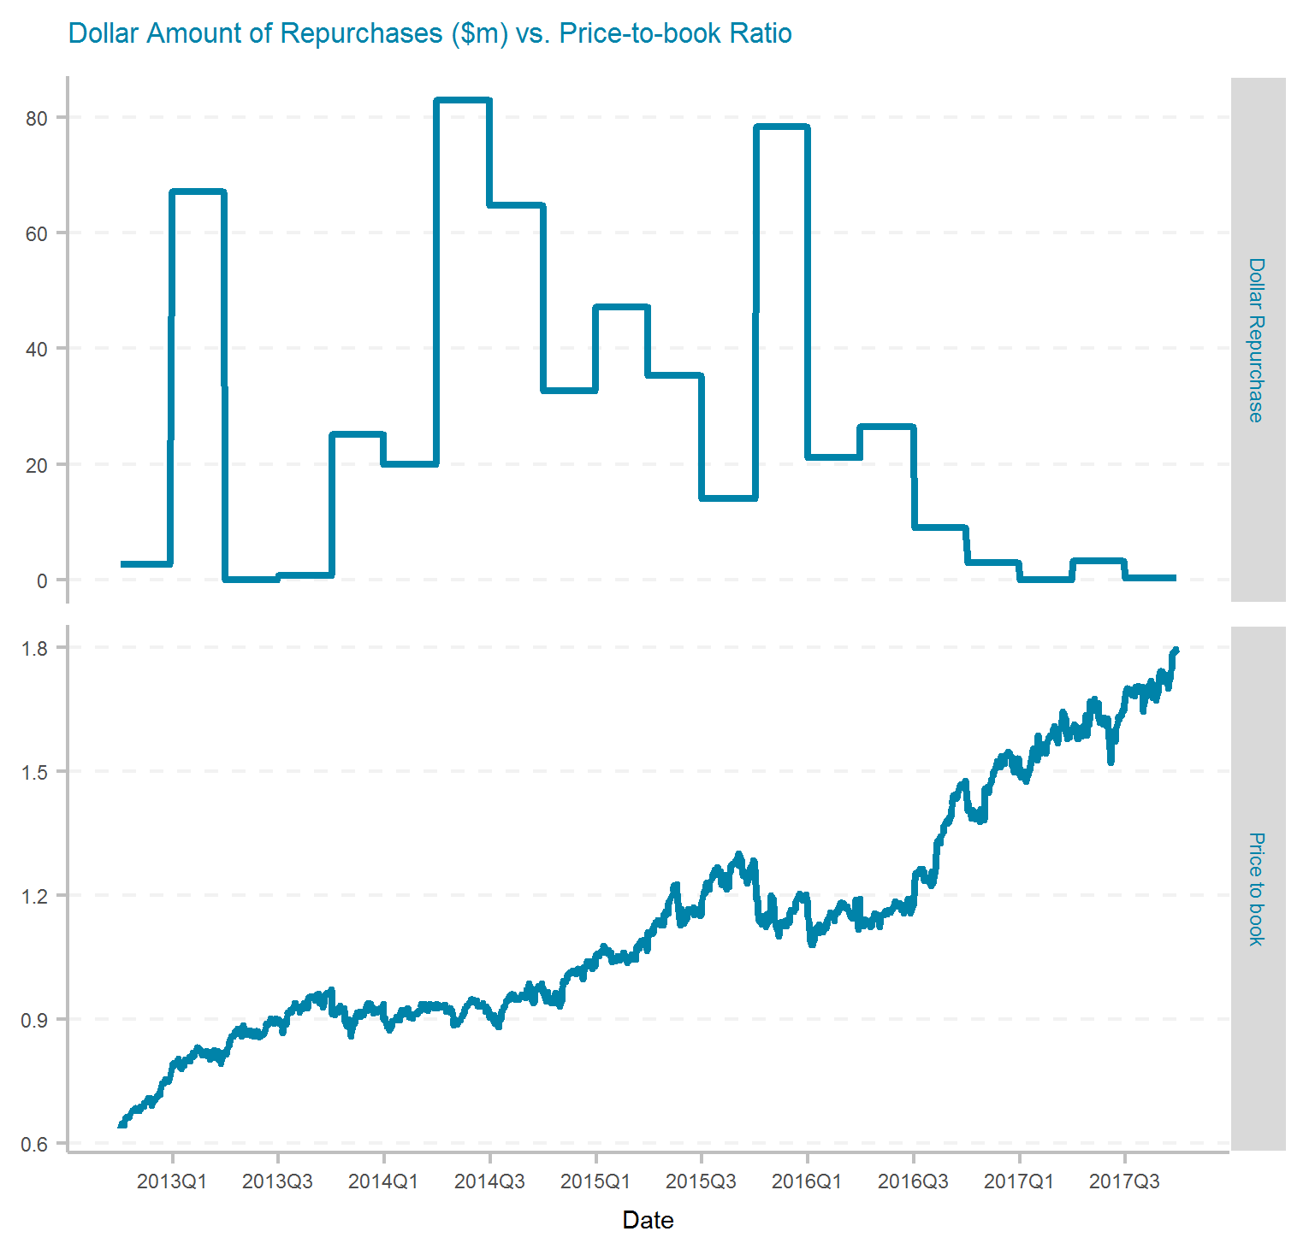
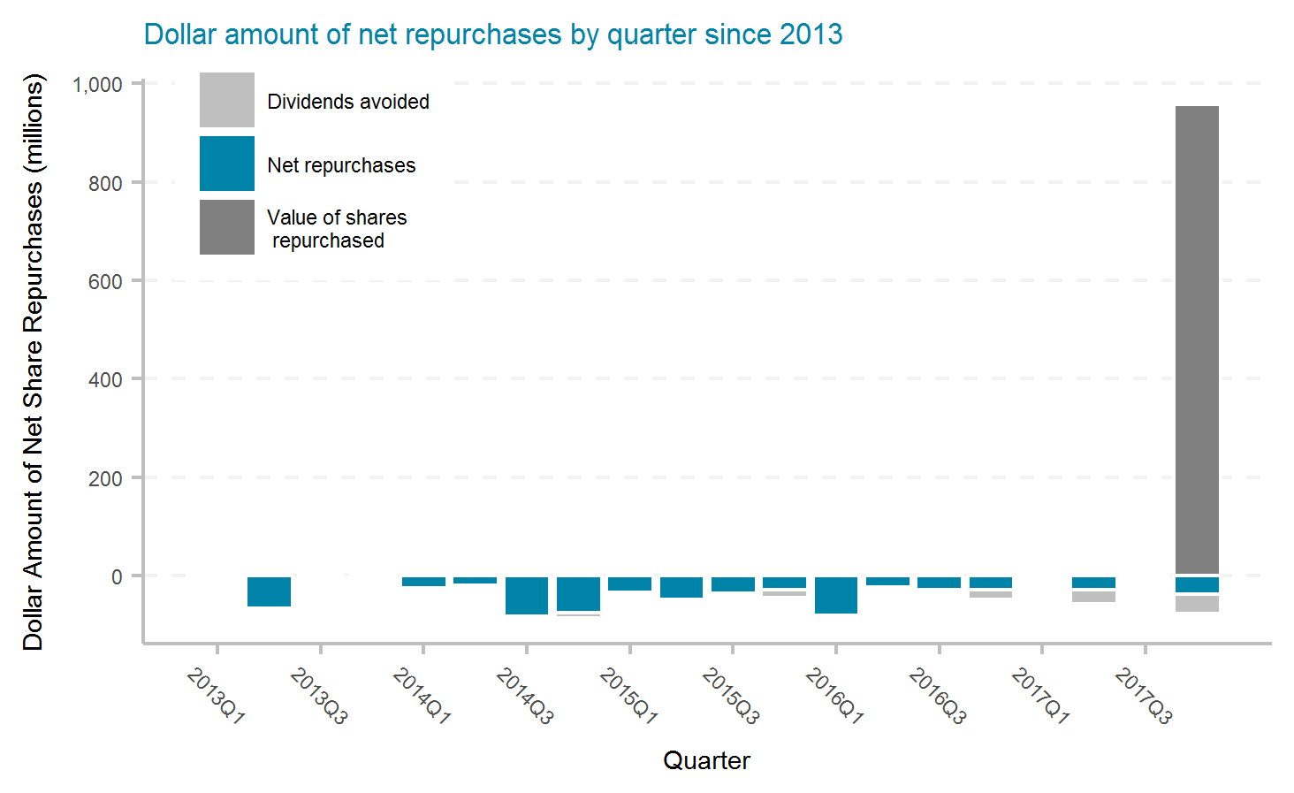
American Financial Group, Inc.
Ticker | # of quarters | Current Mkt Cap ($m) | Initial Shares (mil) | Shares Repurchased (mil) | Dollar Repurchased ($m) | Percent of Initial Shares Repurchased | Percent of Mkt Cap Repurchased | Total Shareholder Return | Buyback ROI | Buyback Effectiveness
AFG | 20 | 10,060 | 89.9 | 8.8 | 534 | 9.8% | 5.3% | 22.1% | 30.2% | 6.6%

Slide 11
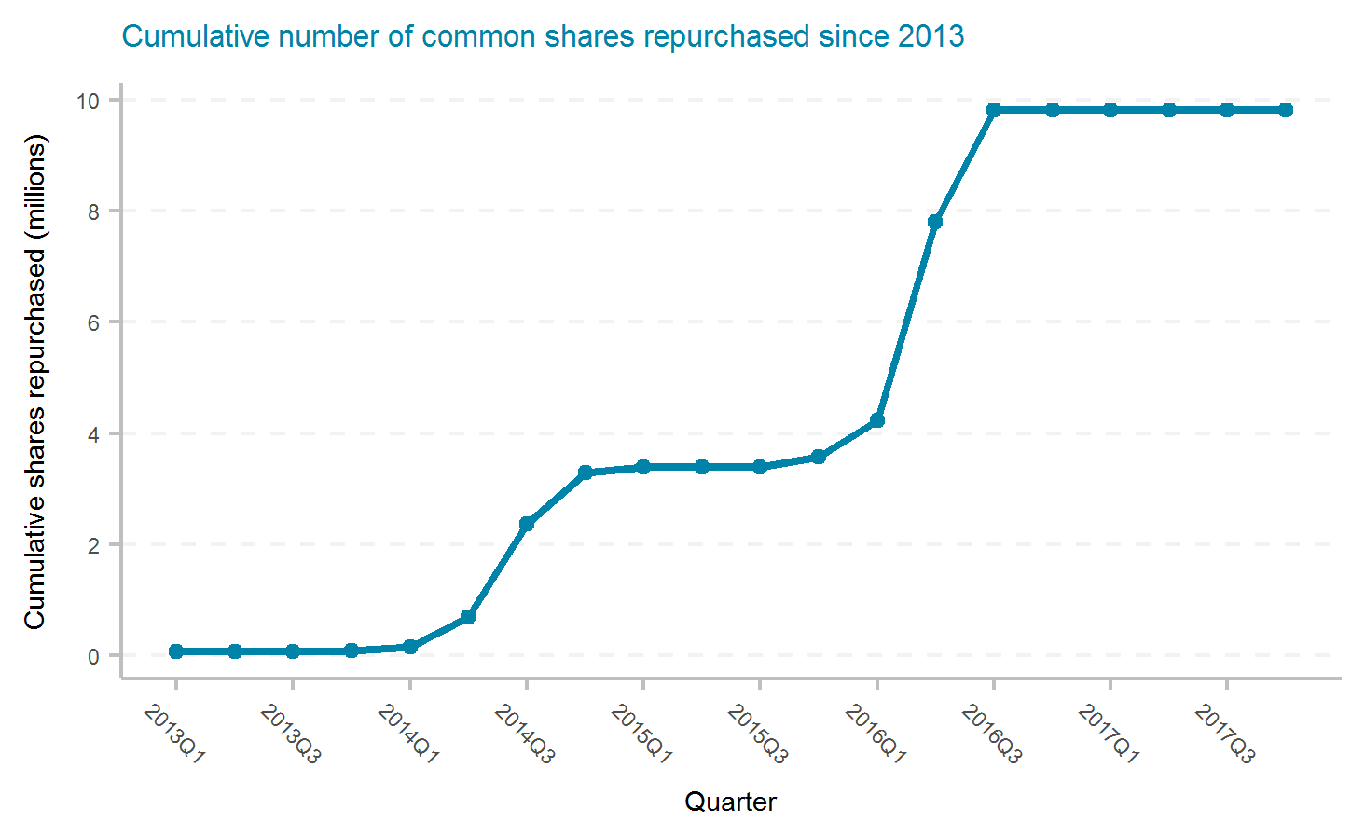
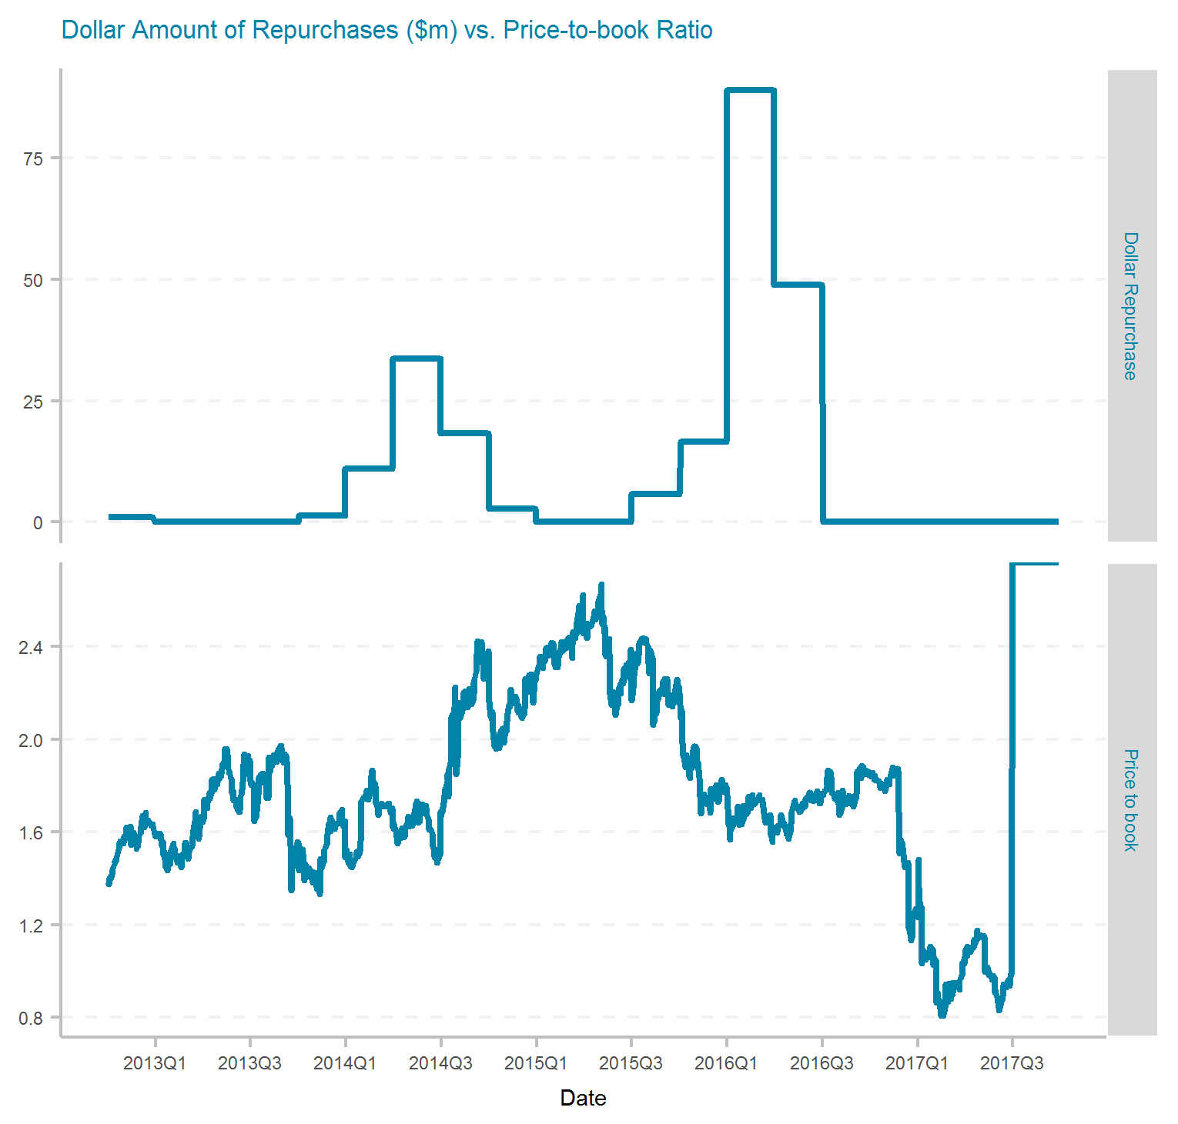
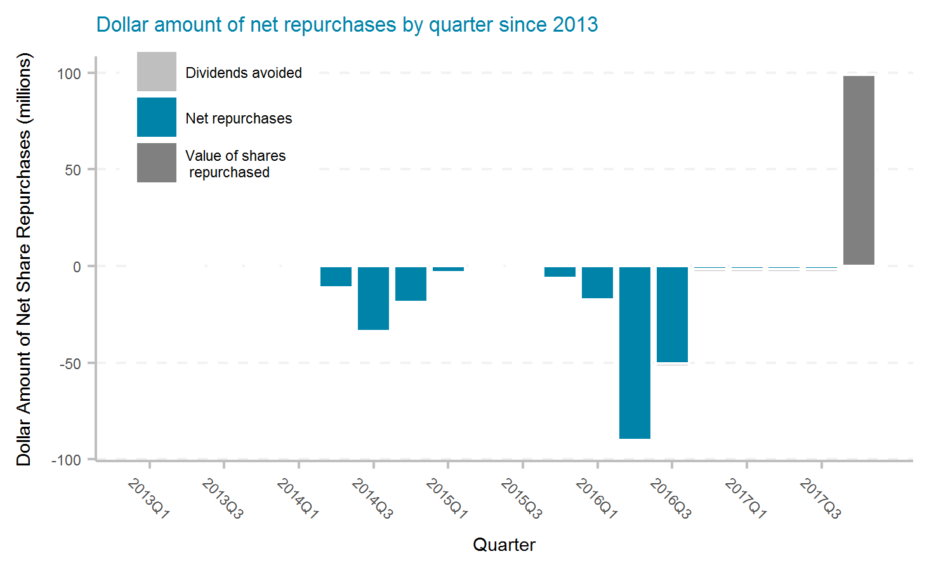
AmTrust Financial Services, Inc.
Ticker | # of quarters | Current Mkt Cap ($m) | Initial Shares (mil) | Shares Repurchased (mil) | Dollar Repurchased ($m) | Percent of Initial Shares Repurchased | Percent of Mkt Cap Repurchased | Total Shareholder Return | Buyback ROI | Buyback Effectiveness
AFSI | 20 | 2,530 | 148.1 | 9.8 | 228 | 6.6% | 9.0% | Inf% | -33.3% | -100.0%

Slide 12
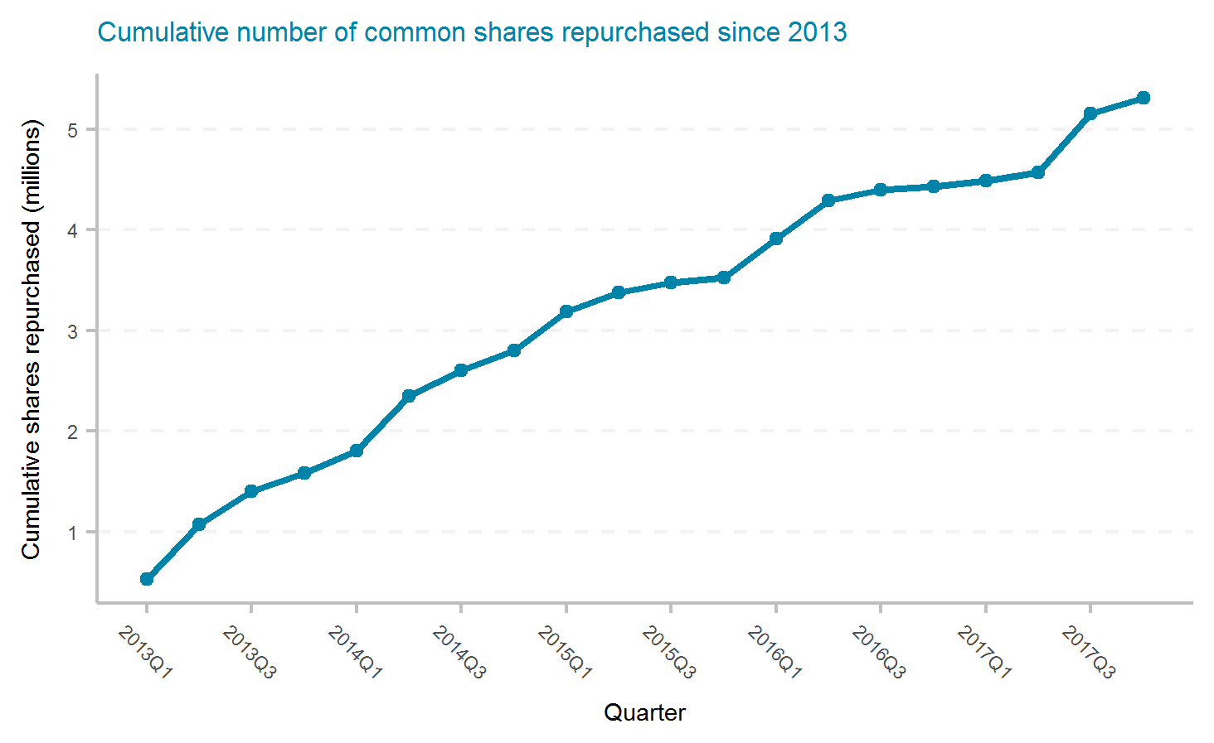
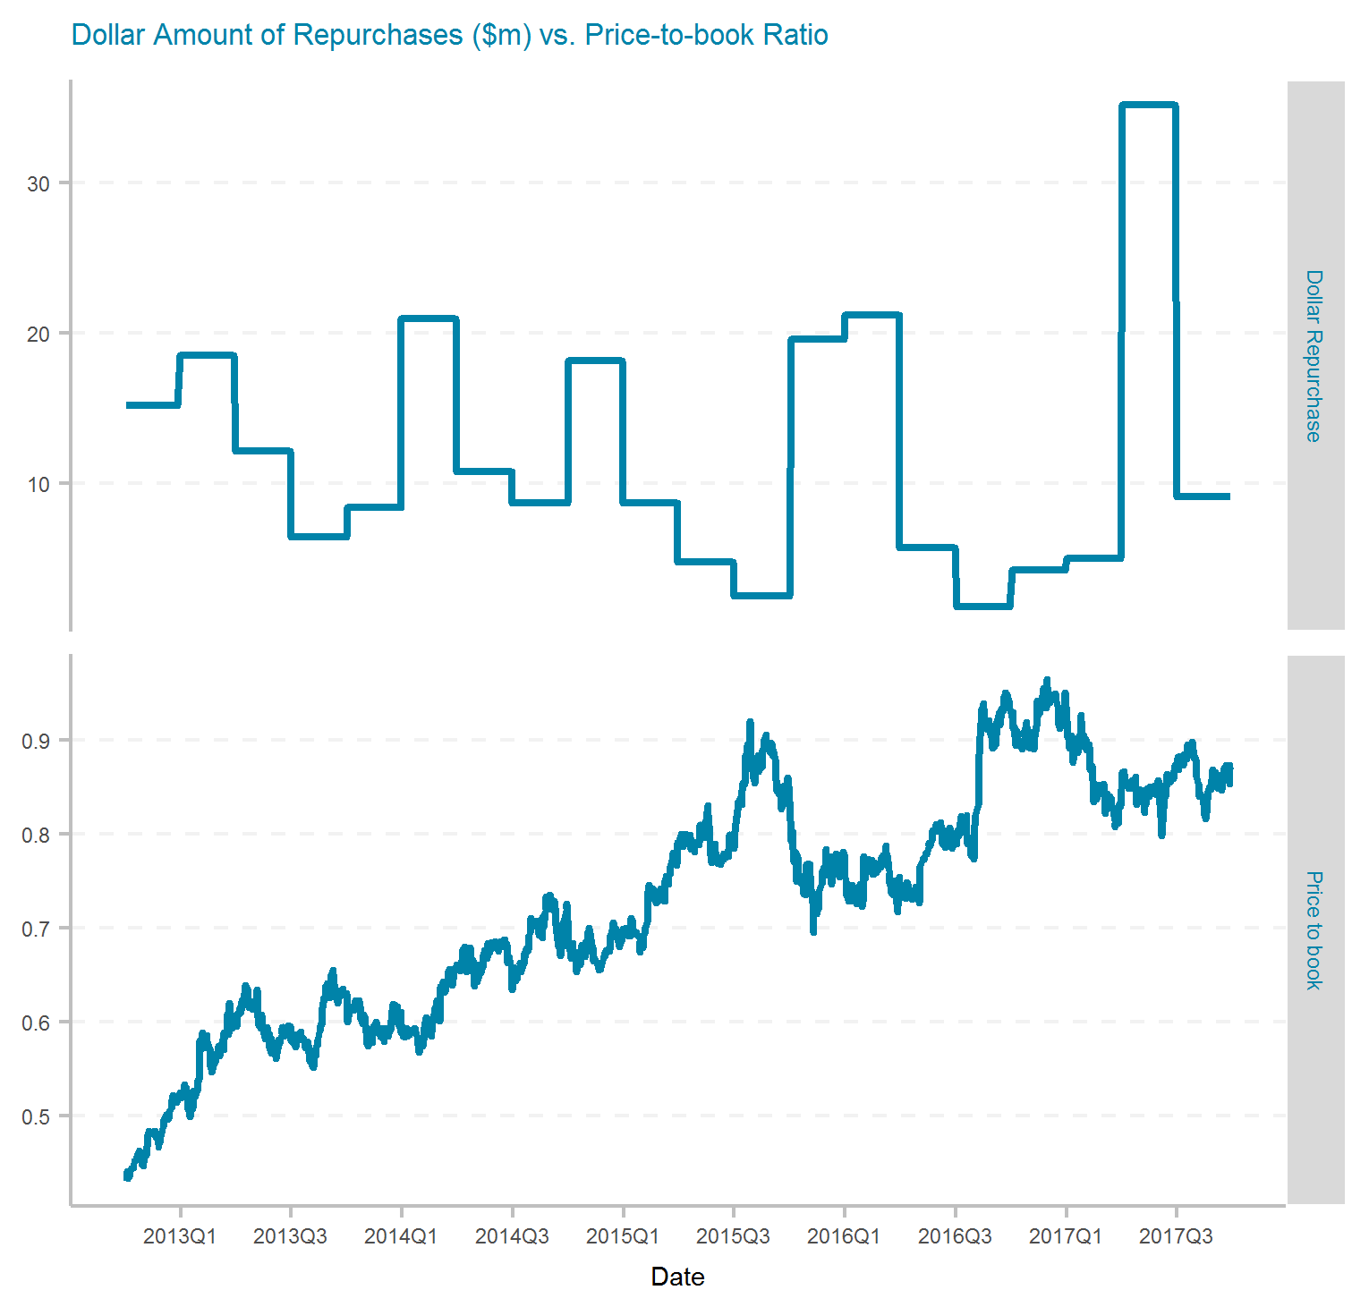
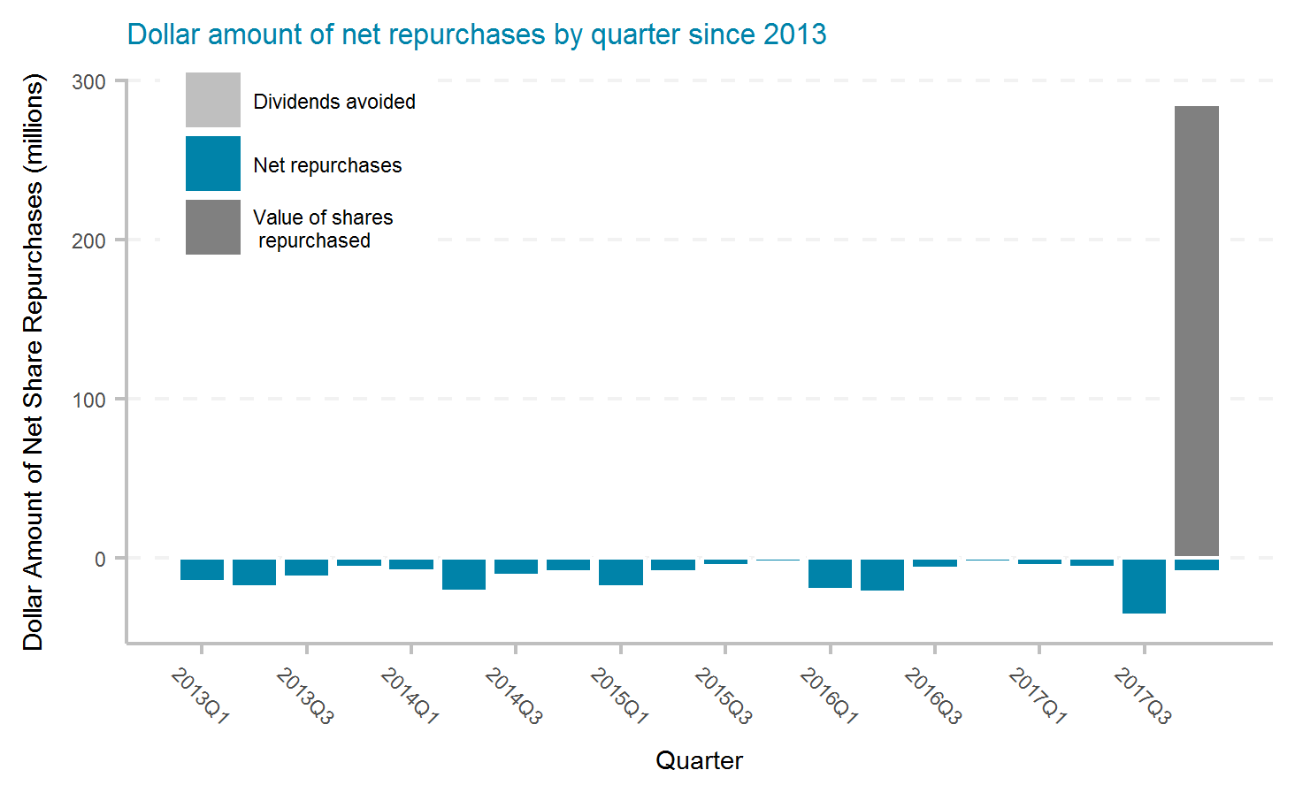
Argo Group International Holdings, Ltd.
Ticker | # of quarters | Current Mkt Cap ($m) | Initial Shares (mil) | Shares Repurchased (mil) | Dollar Repurchased ($m) | Percent of Initial Shares Repurchased | Percent of Mkt Cap Repurchased | Total Shareholder Return | Buyback ROI | Buyback Effectiveness
AGII | 20 | 1,710 | 32.8 | 5.3 | 237 | 16.2% | 13.8% | 16.2% | 9.6% | -5.7%

Slide 13
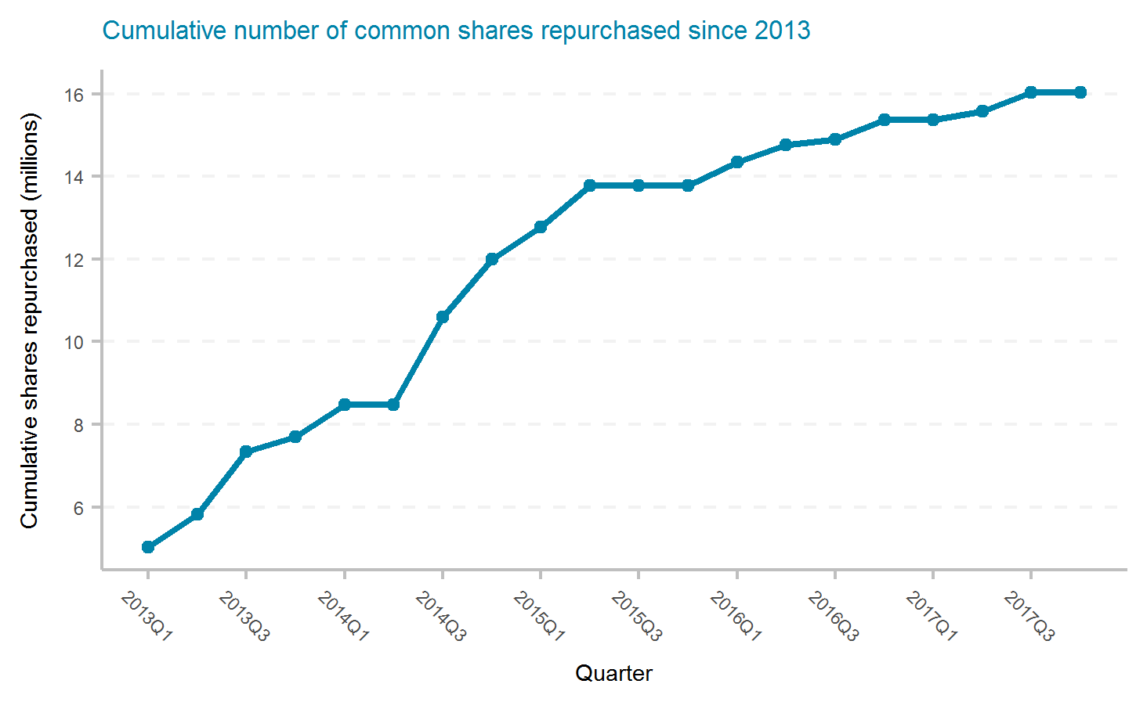
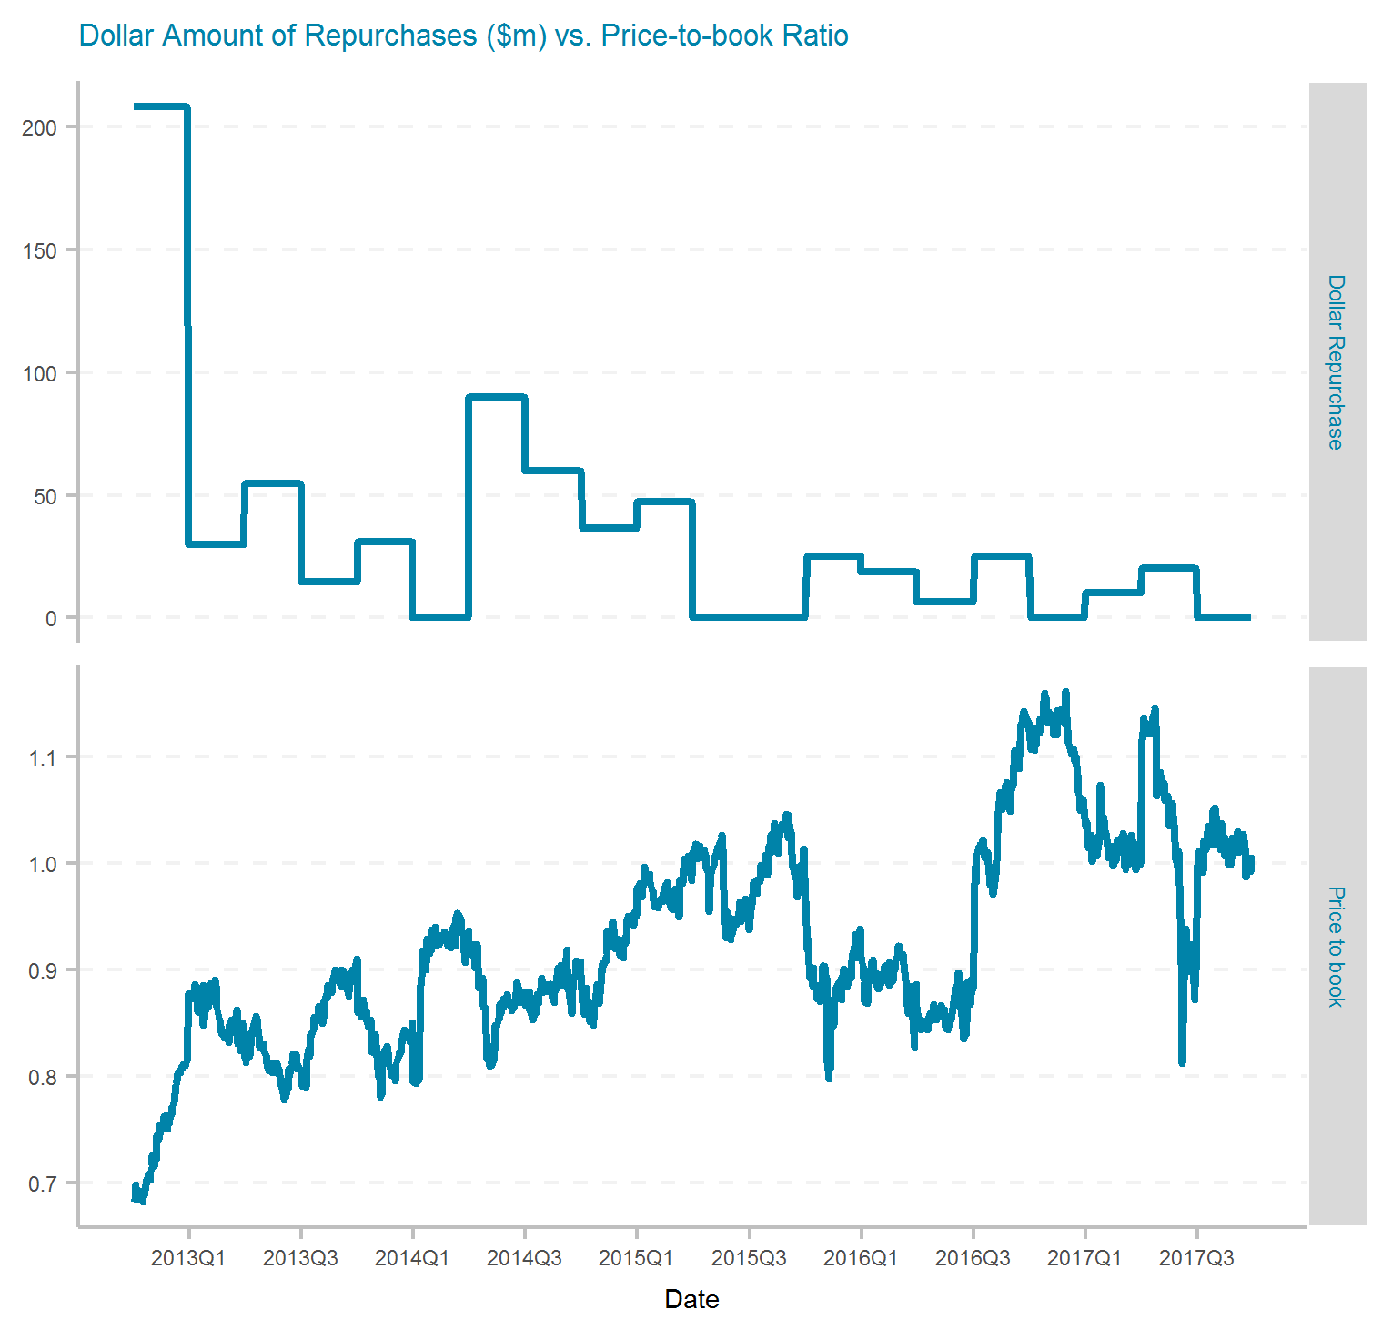
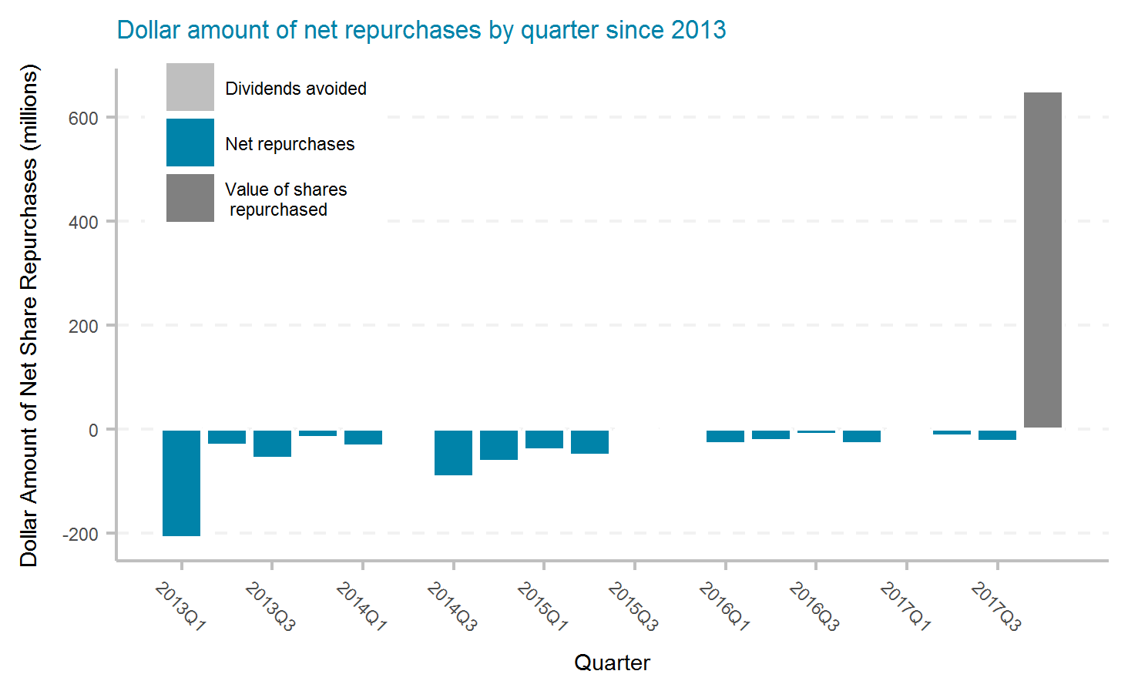
Aspen Insurance Holdings Limited
Ticker | # of quarters | Current Mkt Cap ($m) | Initial Shares (mil) | Shares Repurchased (mil) | Dollar Repurchased ($m) | Percent of Initial Shares Repurchased | Percent of Mkt Cap Repurchased | Total Shareholder Return | Buyback ROI | Buyback Effectiveness
AHL | 20 | 2,530 | 65.6 | 16.0 | 677 | 24.4% | 26.8% | 3.1% | 1.1% | -1.9%

Slide 14
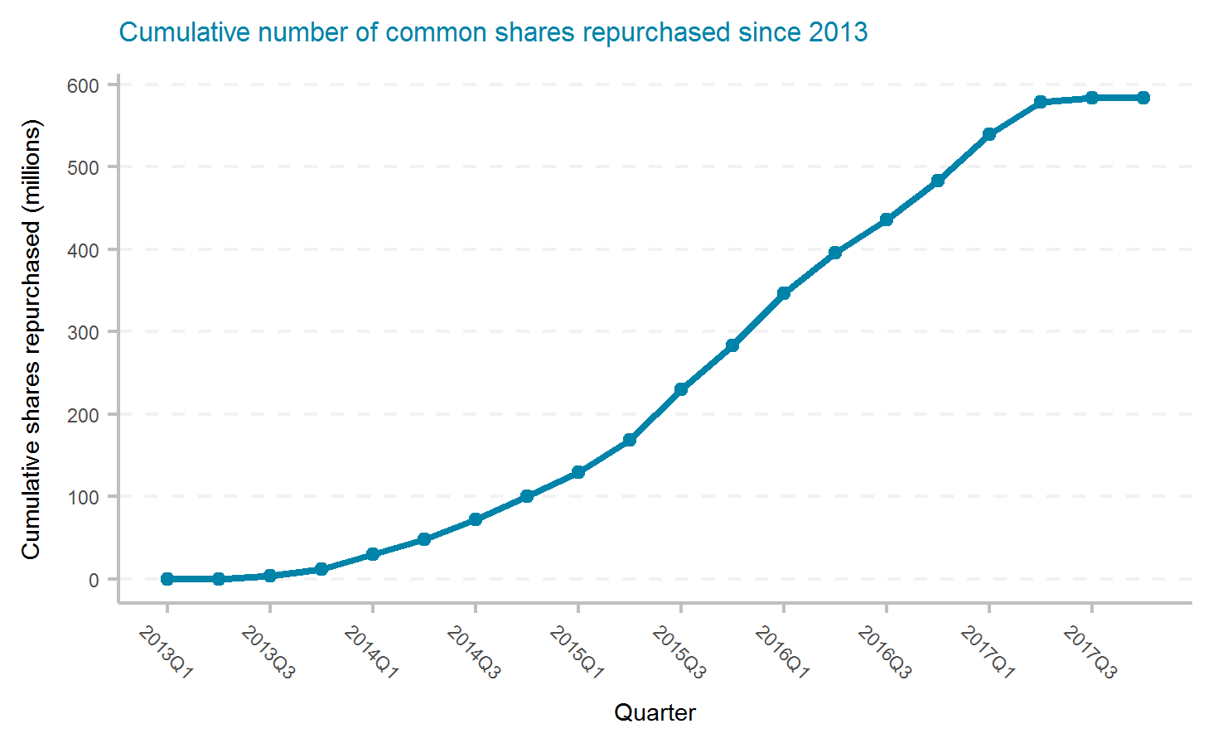
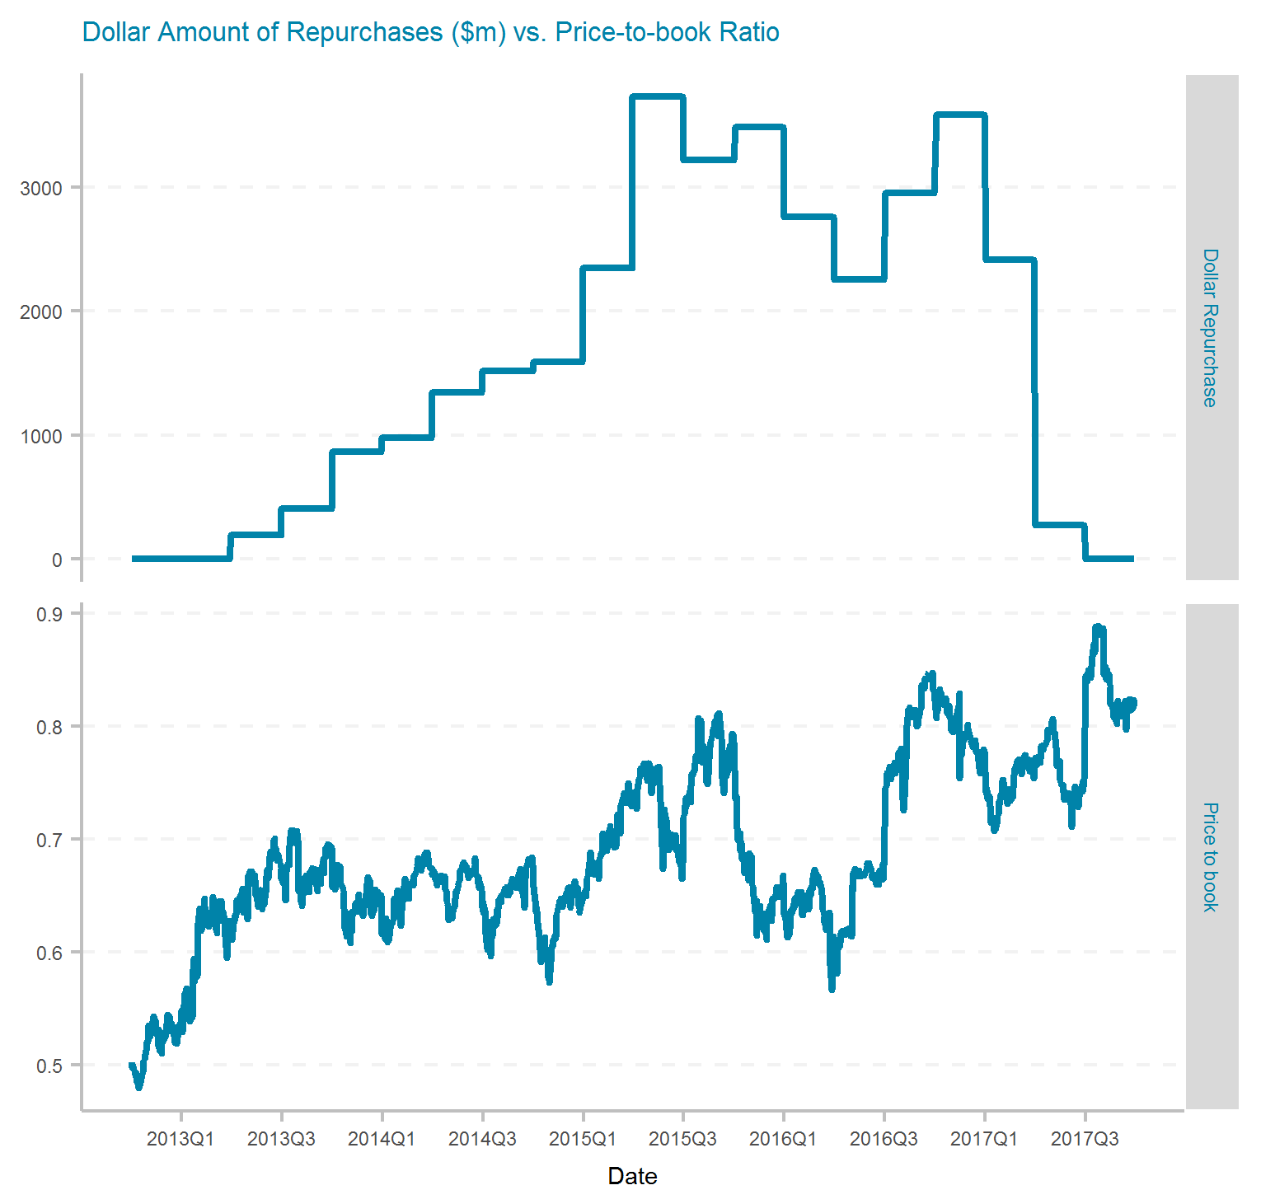
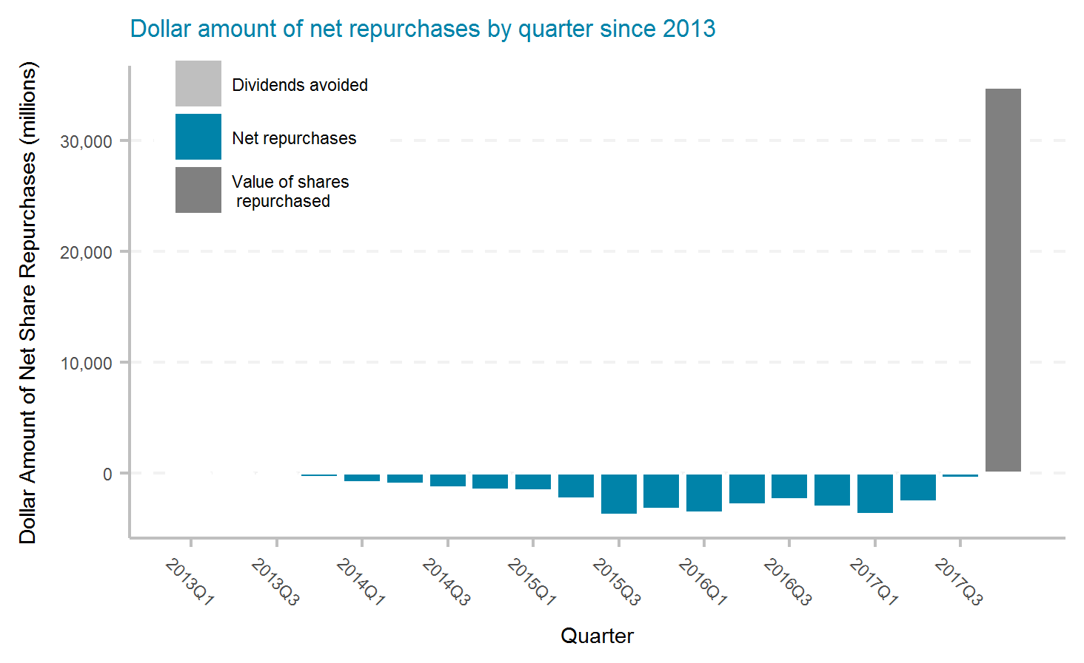
American International Group, Inc.
Ticker | # of quarters | Current Mkt Cap ($m) | Initial Shares (mil) | Shares Repurchased (mil) | Dollar Repurchased ($m) | Percent of Initial Shares Repurchased | Percent of Mkt Cap Repurchased | Total Shareholder Return | Buyback ROI | Buyback Effectiveness
AIG | 20 | 50,570 | 1,476.3 | 583.2 | 33,927 | 39.5% | 67.1% | 10.7% | 3.6% | -6.4%

Slide 15
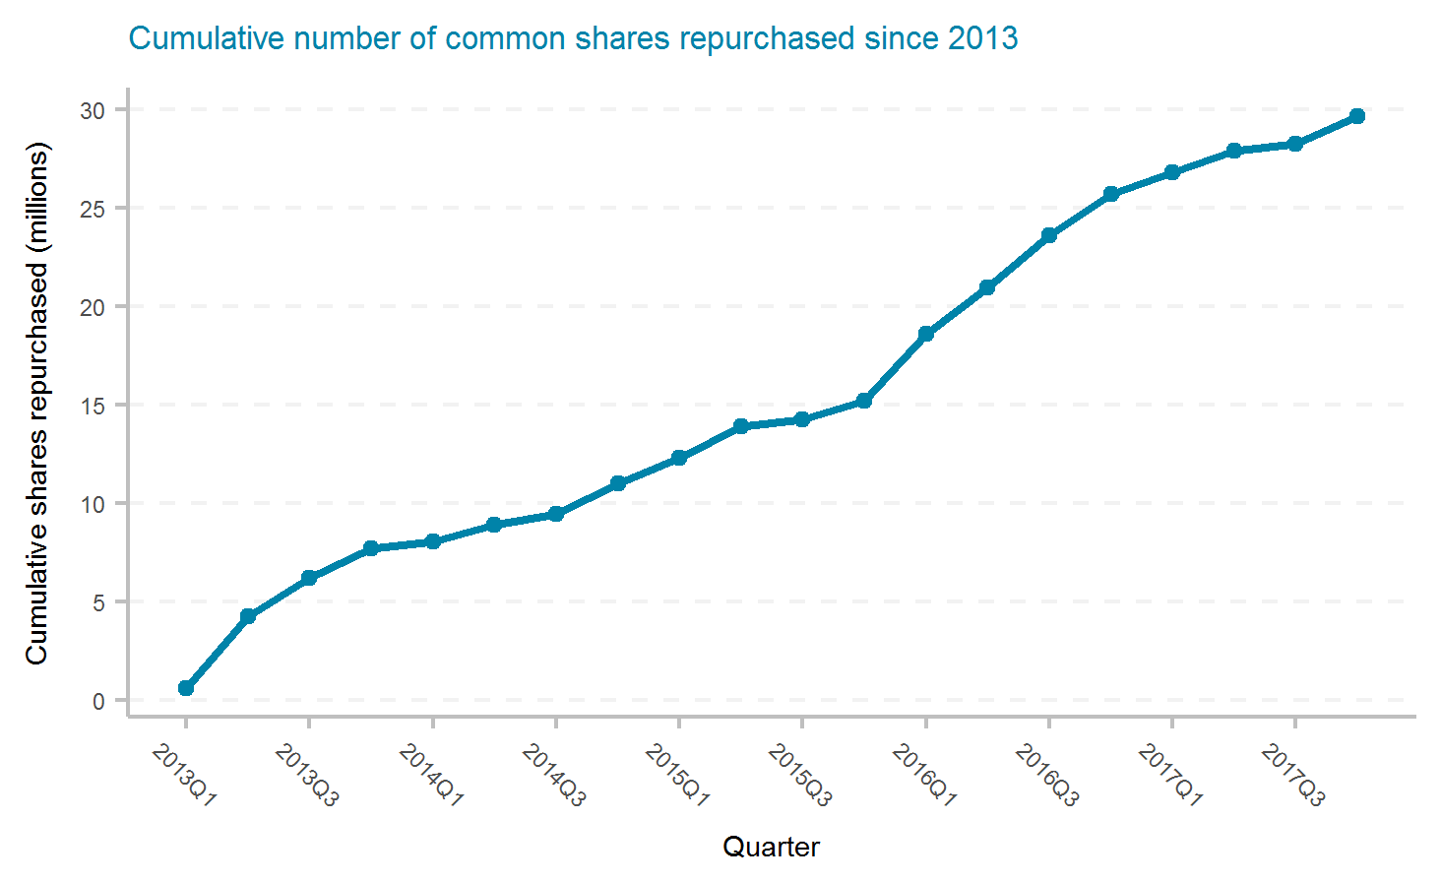
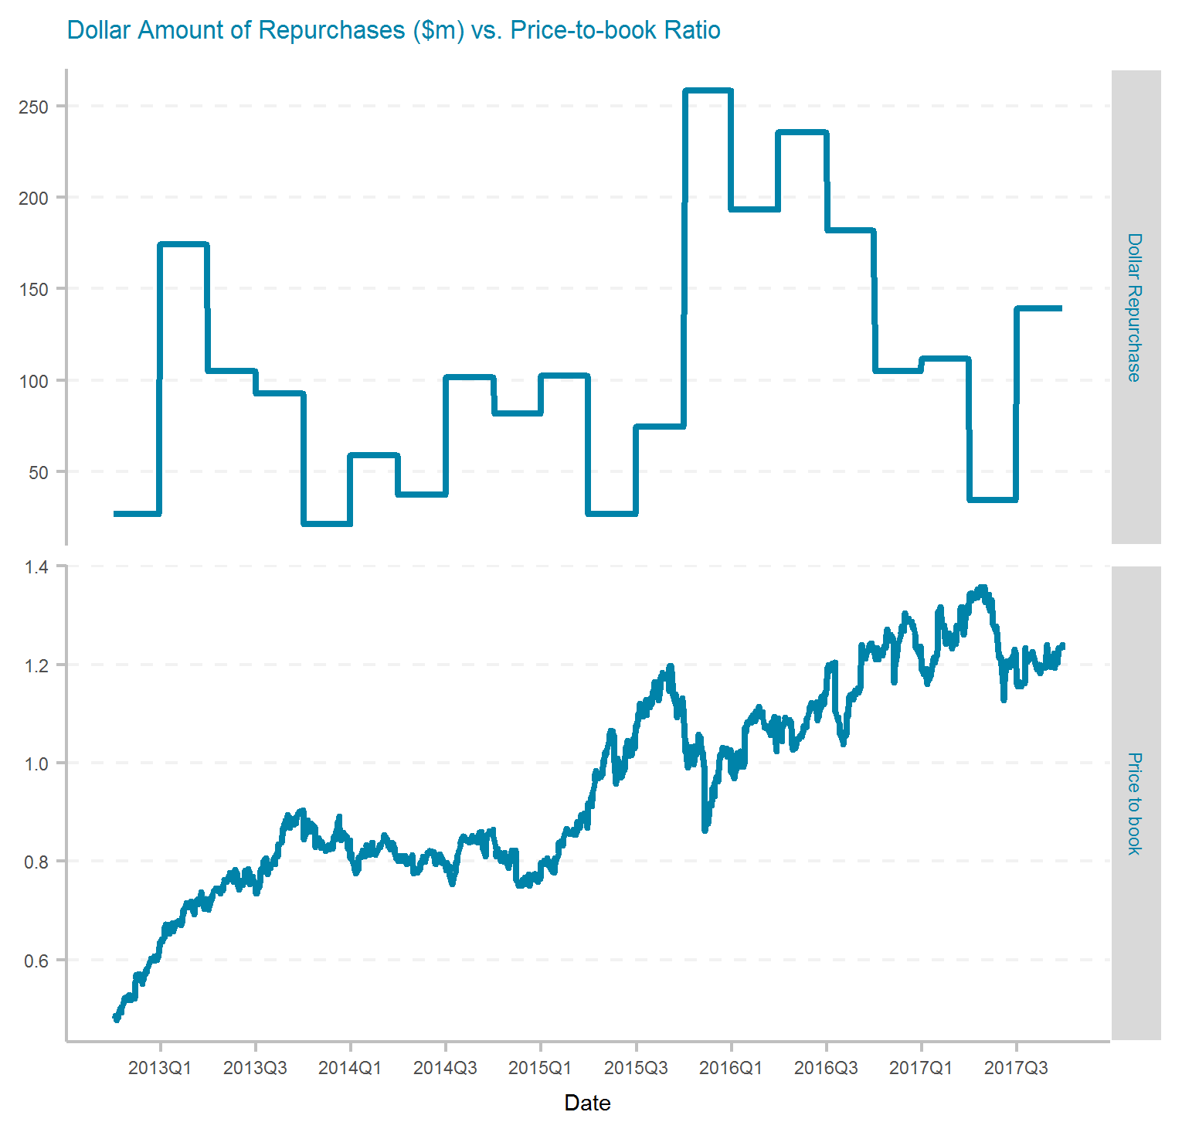
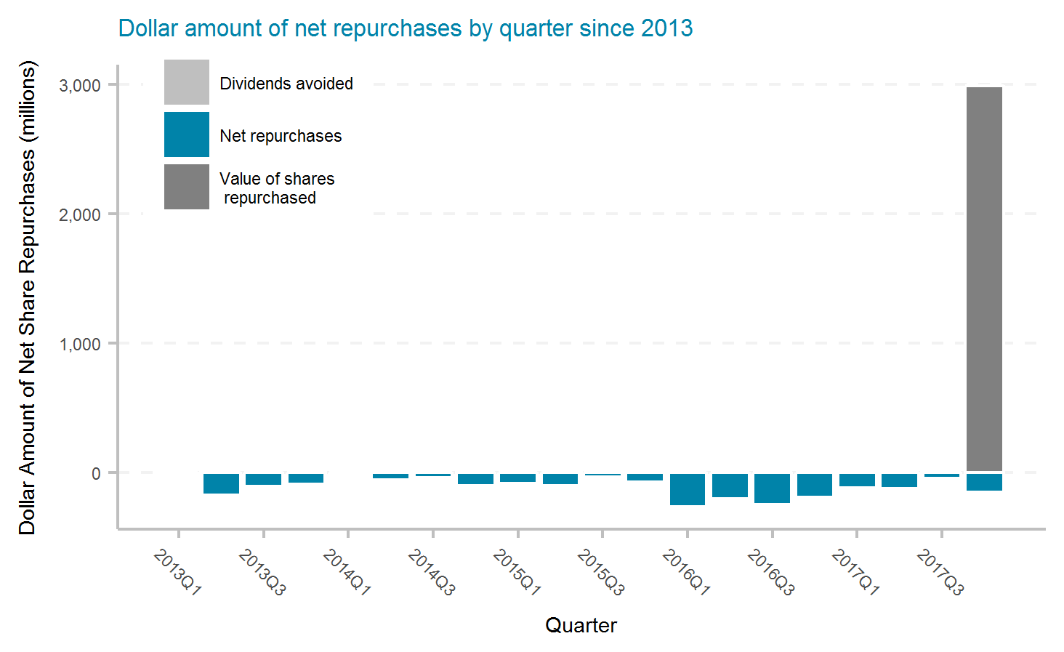
Assurant, Inc.
Ticker | # of quarters | Current Mkt Cap ($m) | Initial Shares (mil) | Shares Repurchased (mil) | Dollar Repurchased ($m) | Percent of Initial Shares Repurchased | Percent of Mkt Cap Repurchased | Total Shareholder Return | Buyback ROI | Buyback Effectiveness
AIZ | 20 | 4,880 | 78.4 | 29.6 | 2,160 | 37.8% | 44.3% | 19.5% | 18.6% | -0.8%

Slide 16
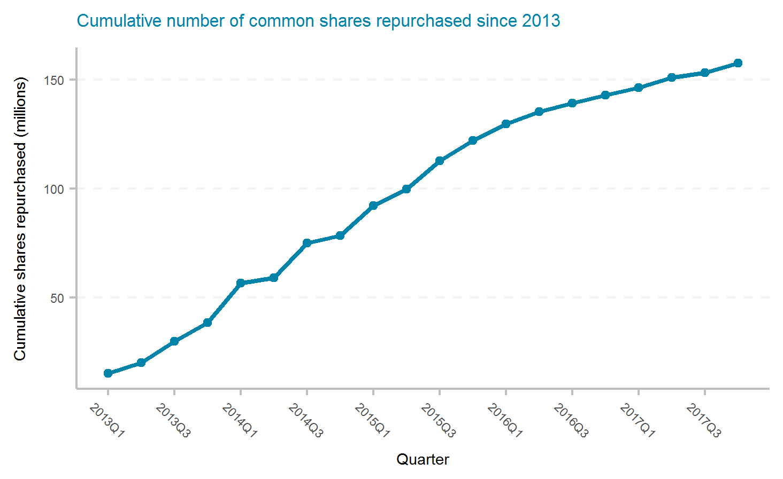
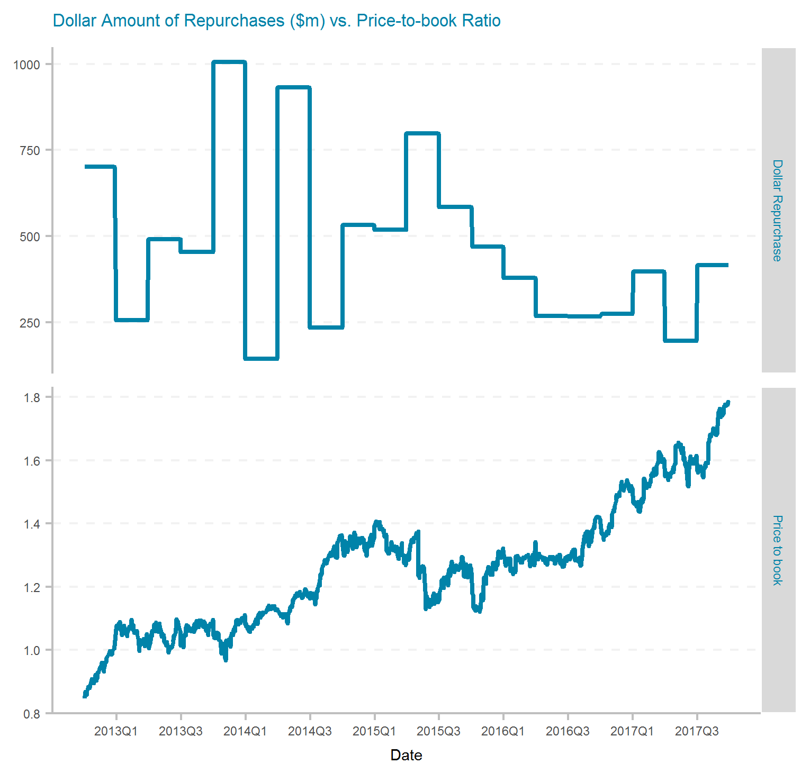
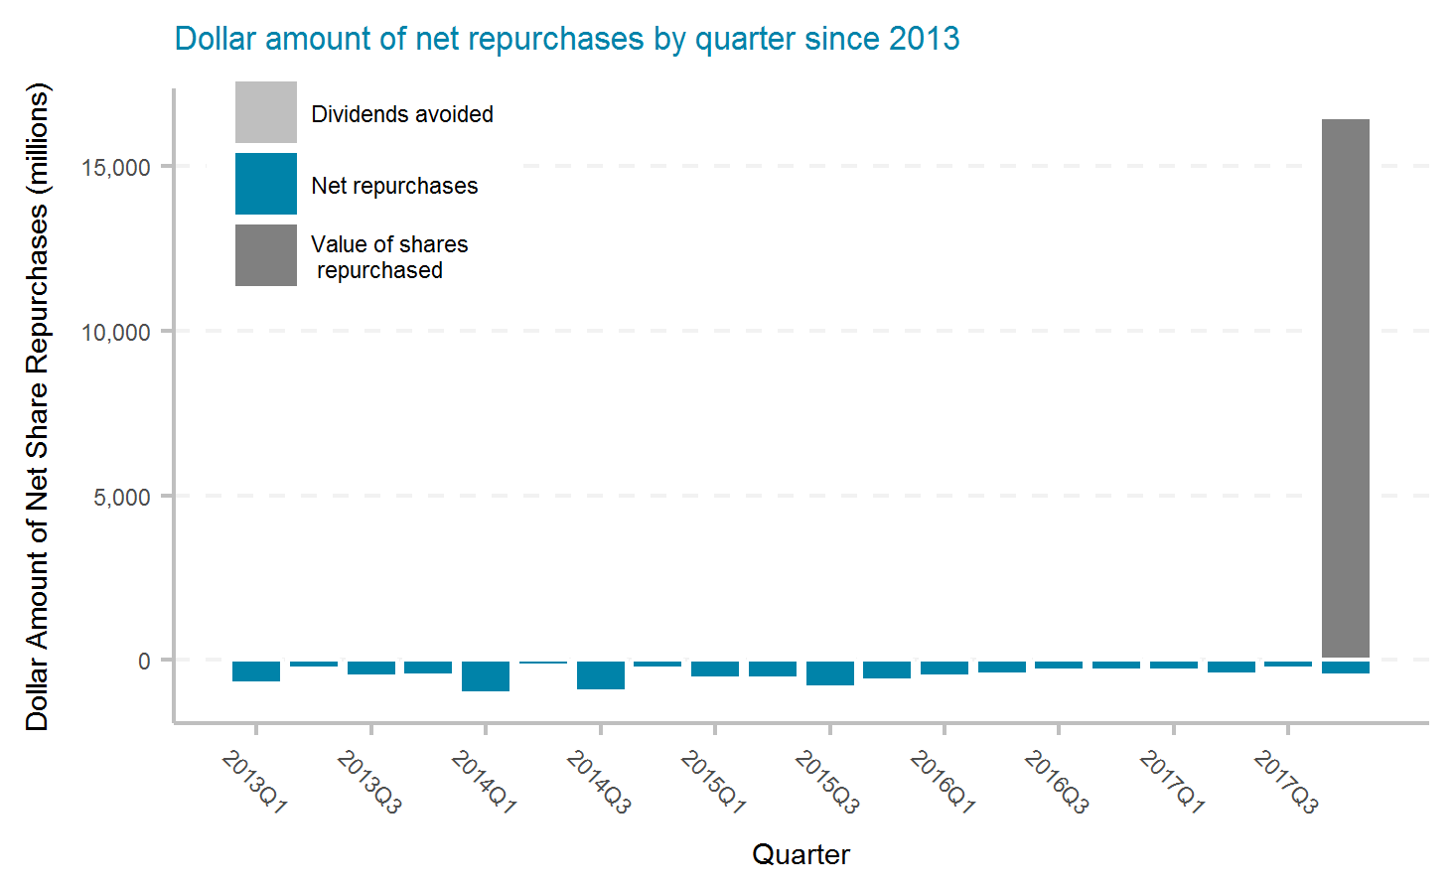
Allstate Corporation
Ticker | # of quarters | Current Mkt Cap ($m) | Initial Shares (mil) | Shares Repurchased (mil) | Dollar Repurchased ($m) | Percent of Initial Shares Repurchased | Percent of Mkt Cap Repurchased | Total Shareholder Return | Buyback ROI | Buyback Effectiveness
ALL | 20 | 34,540 | 468.0 | 157.4 | 9,313 | 33.6% | 27.0% | 17.9% | 24.7% | 5.8%

Slide 17
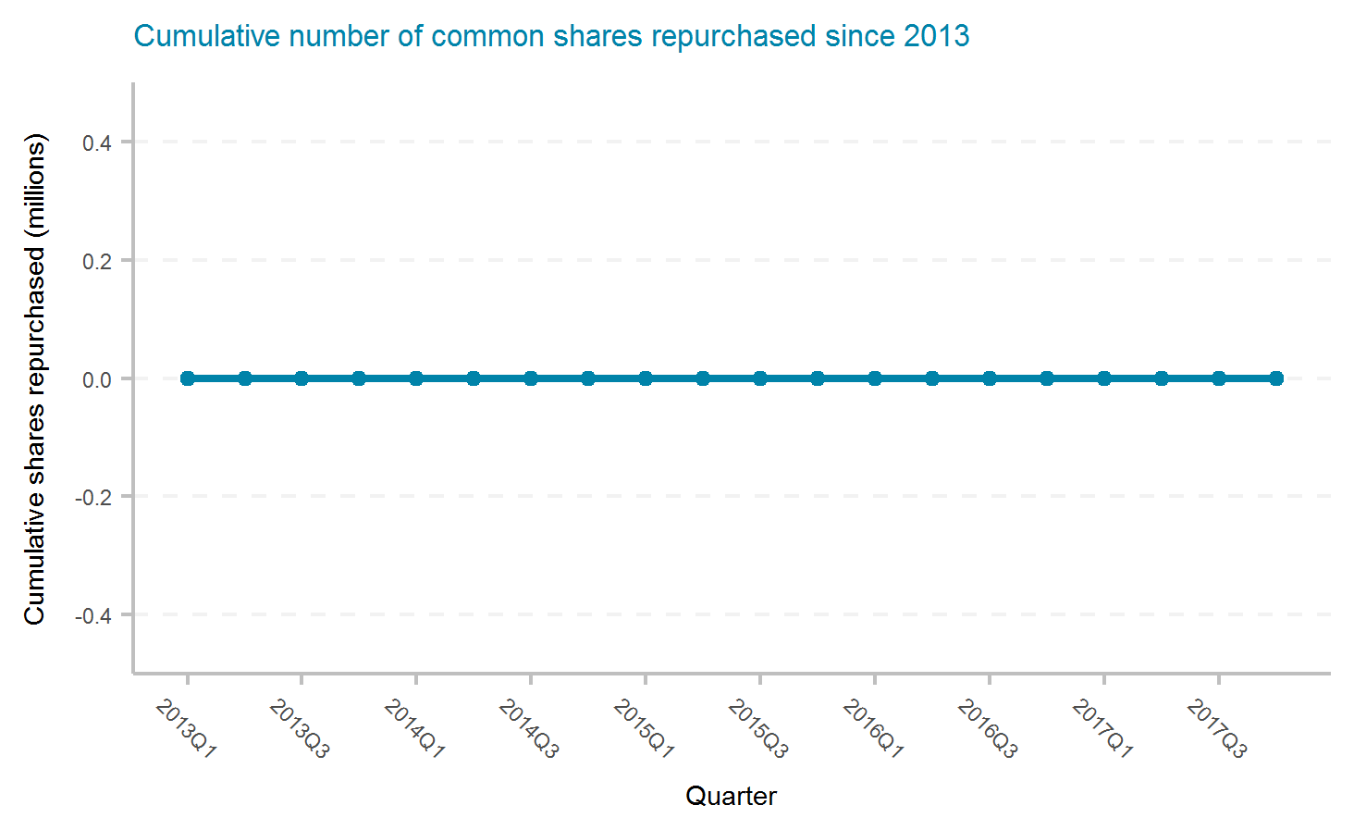
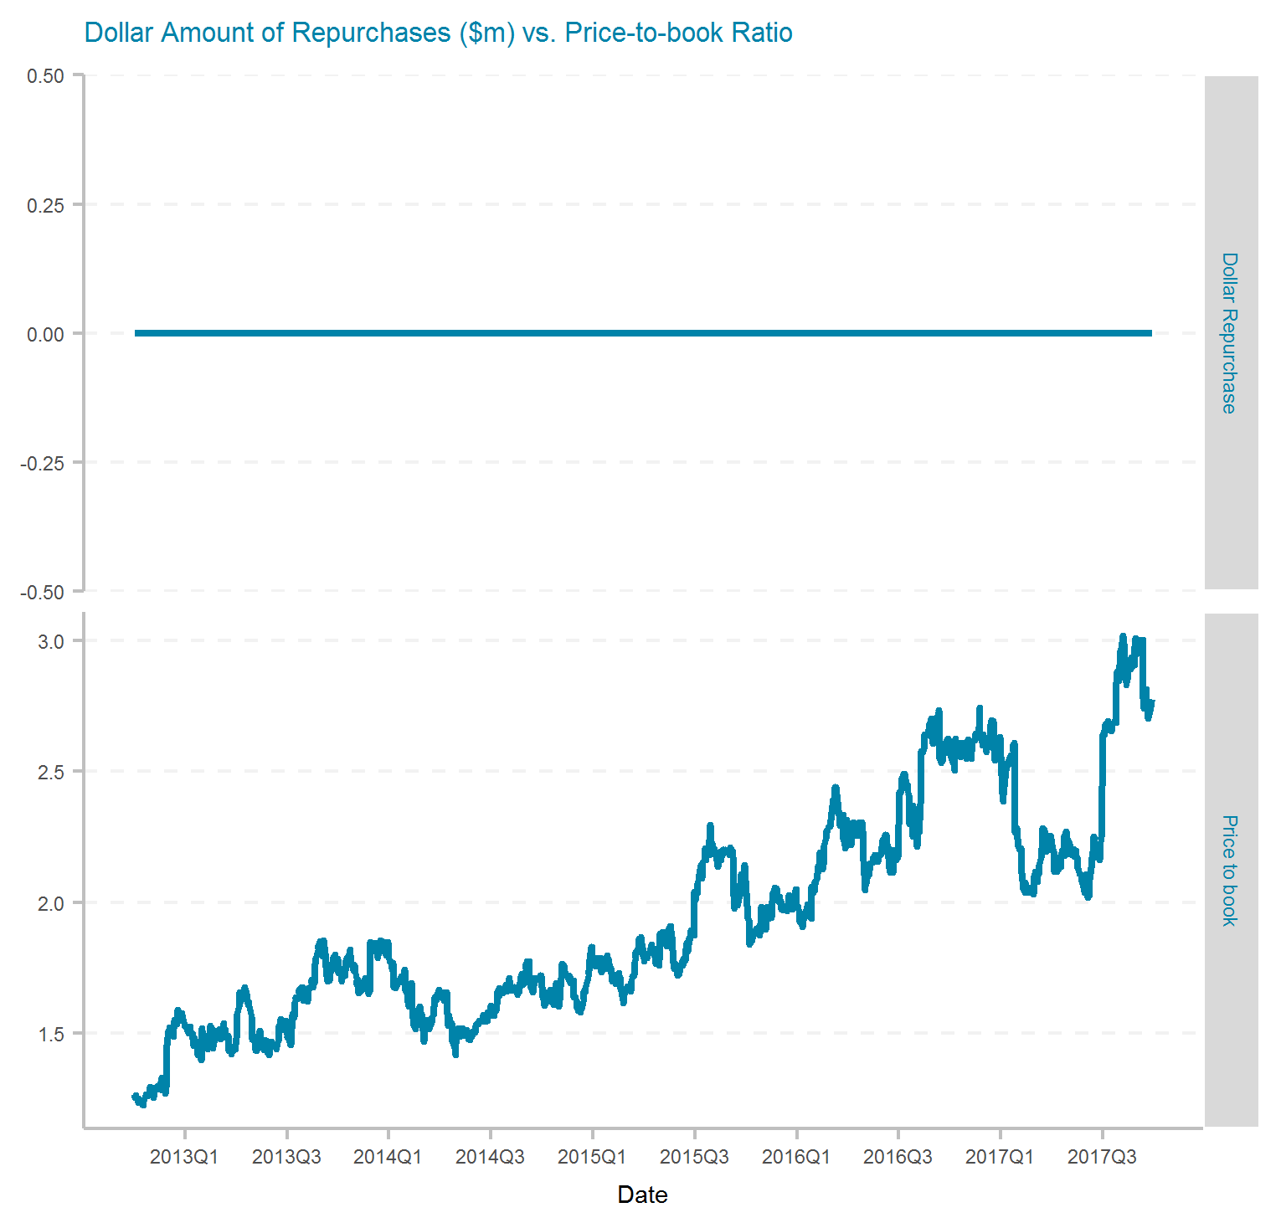
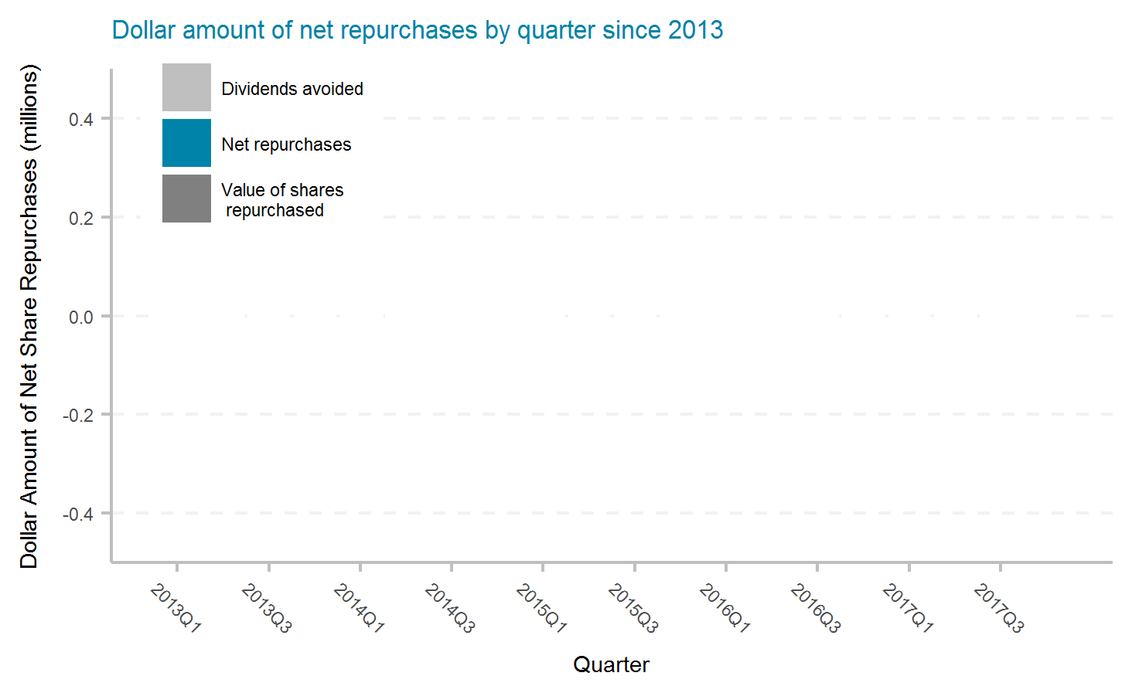
AMERISAFE, Inc.
Ticker | # of quarters | Current Mkt Cap ($m) | Initial Shares (mil) | Shares Repurchased (mil) | Dollar Repurchased ($m) | Percent of Initial Shares Repurchased | Percent of Mkt Cap Repurchased | Total Shareholder Return | Buyback ROI | Buyback Effectiveness

Slide 18
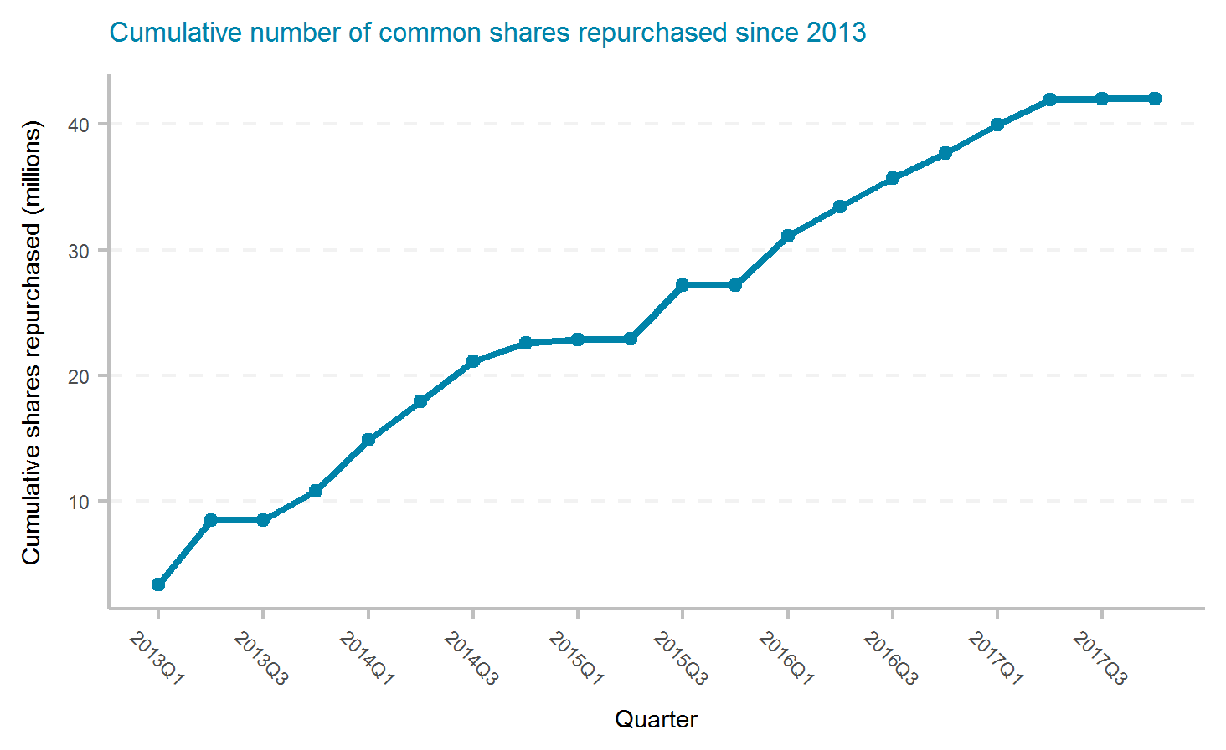
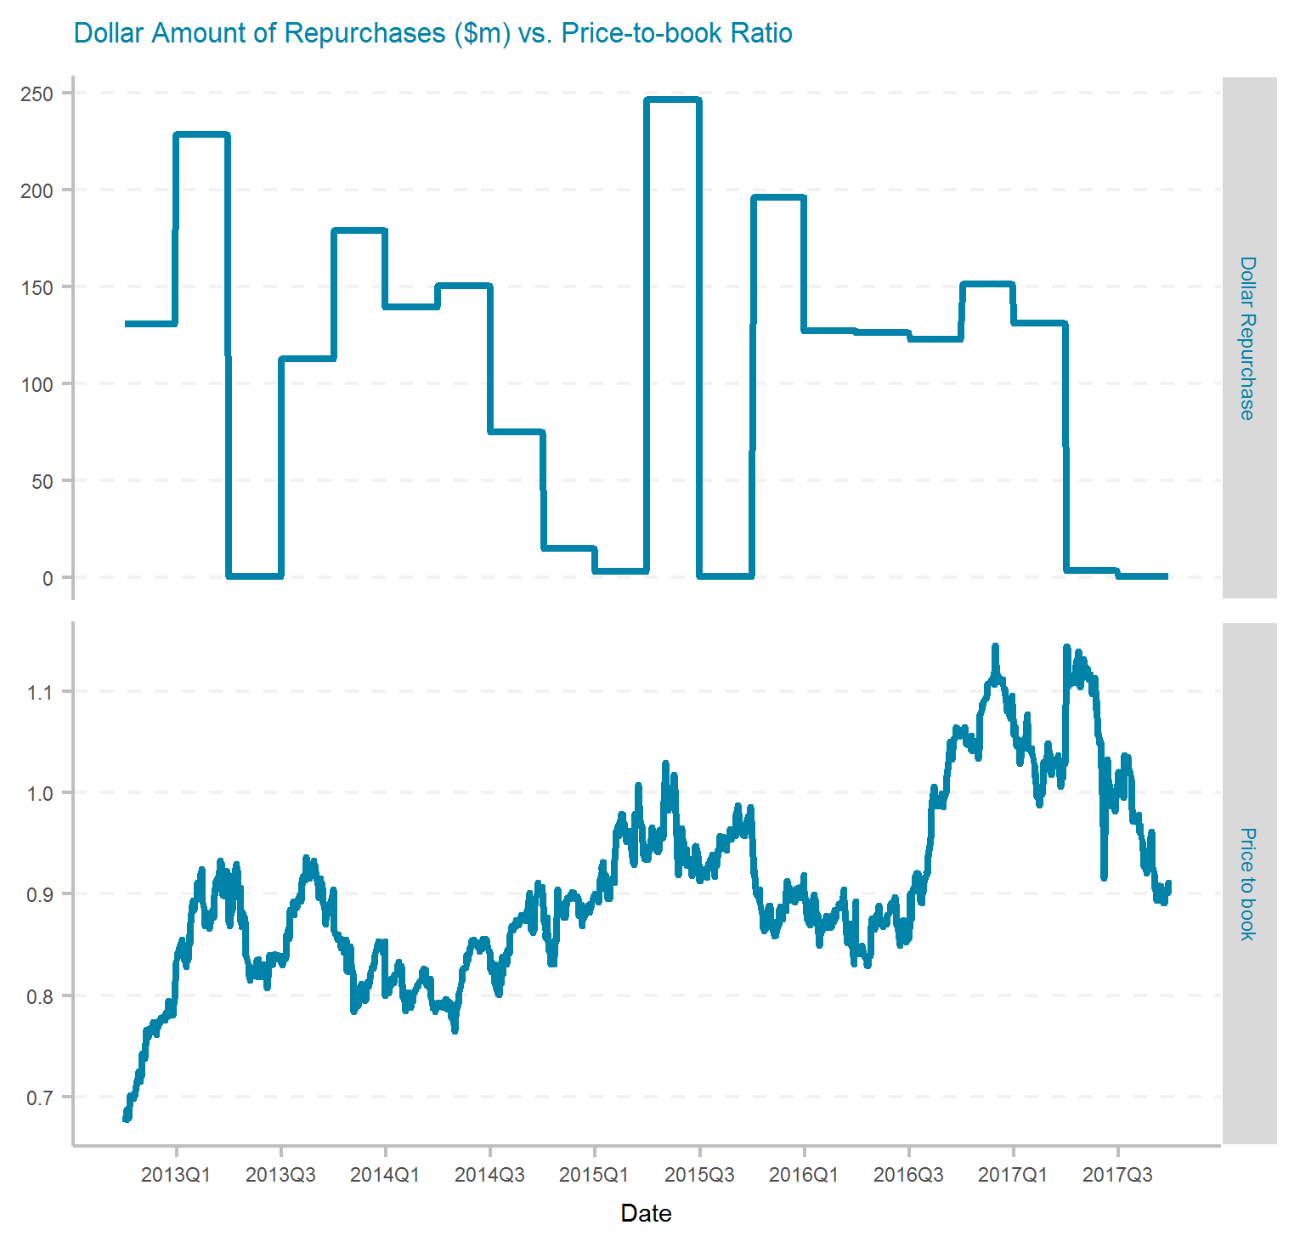
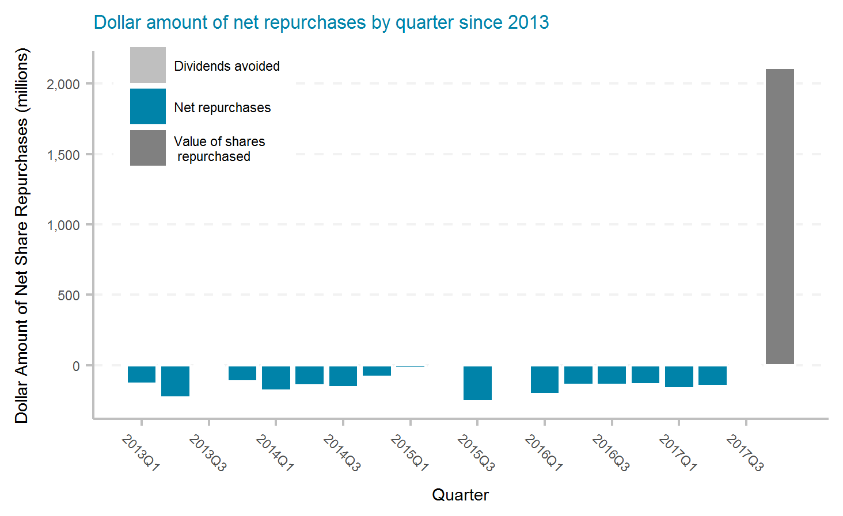
AXIS Capital Holdings Limited
Ticker | # of quarters | Current Mkt Cap ($m) | Initial Shares (mil) | Shares Repurchased (mil) | Dollar Repurchased ($m) | Percent of Initial Shares Repurchased | Percent of Mkt Cap Repurchased | Total Shareholder Return | Buyback ROI | Buyback Effectiveness
AXS | 20 | 4,900 | 116.3 | 42.0 | 2,138 | 36.1% | 43.6% | 6.7% | 2.7% | -3.8%

Slide 19
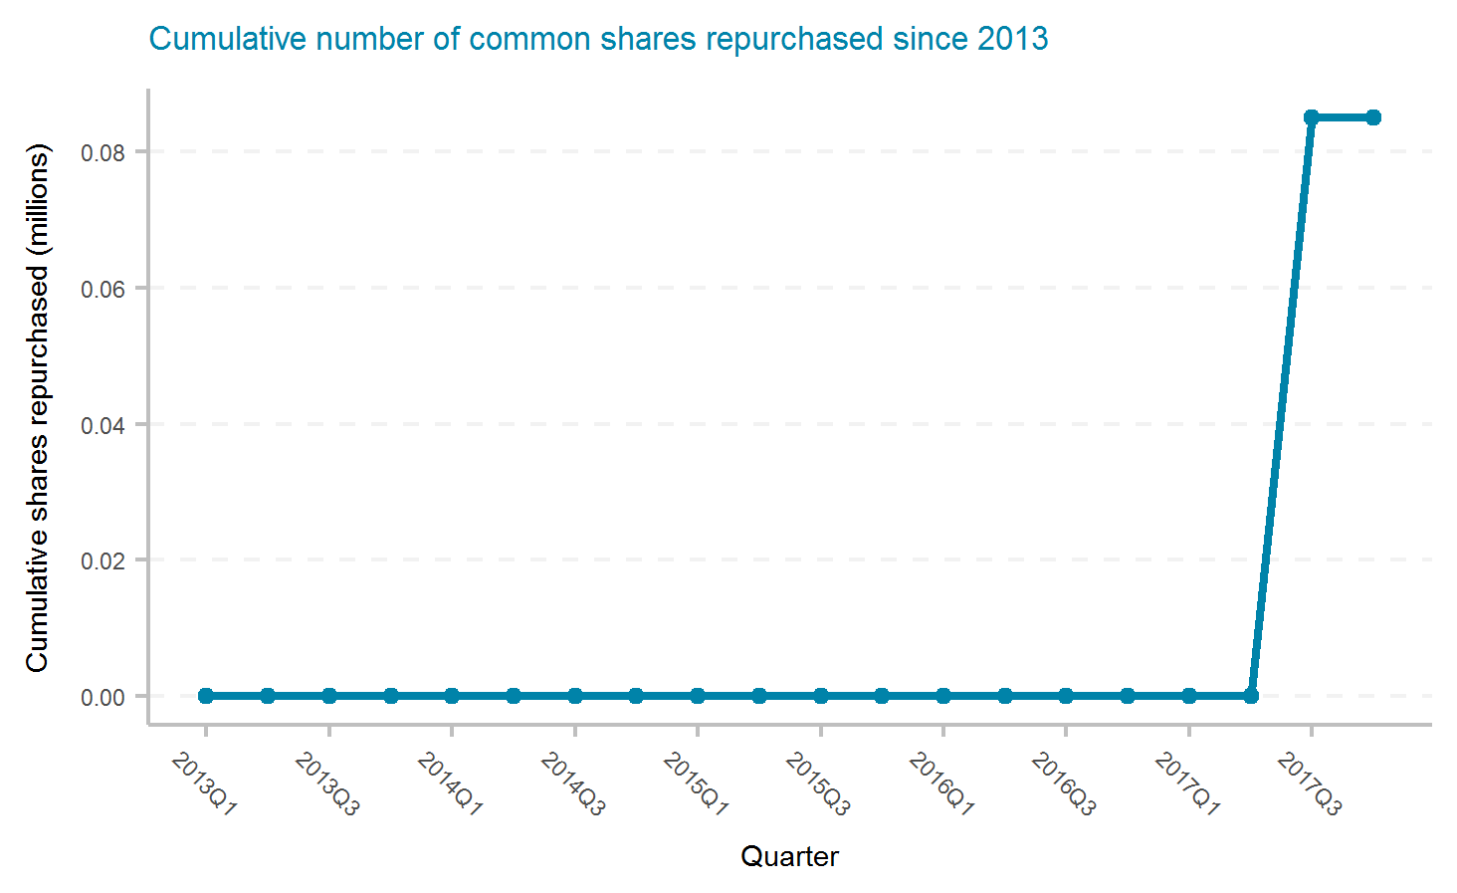
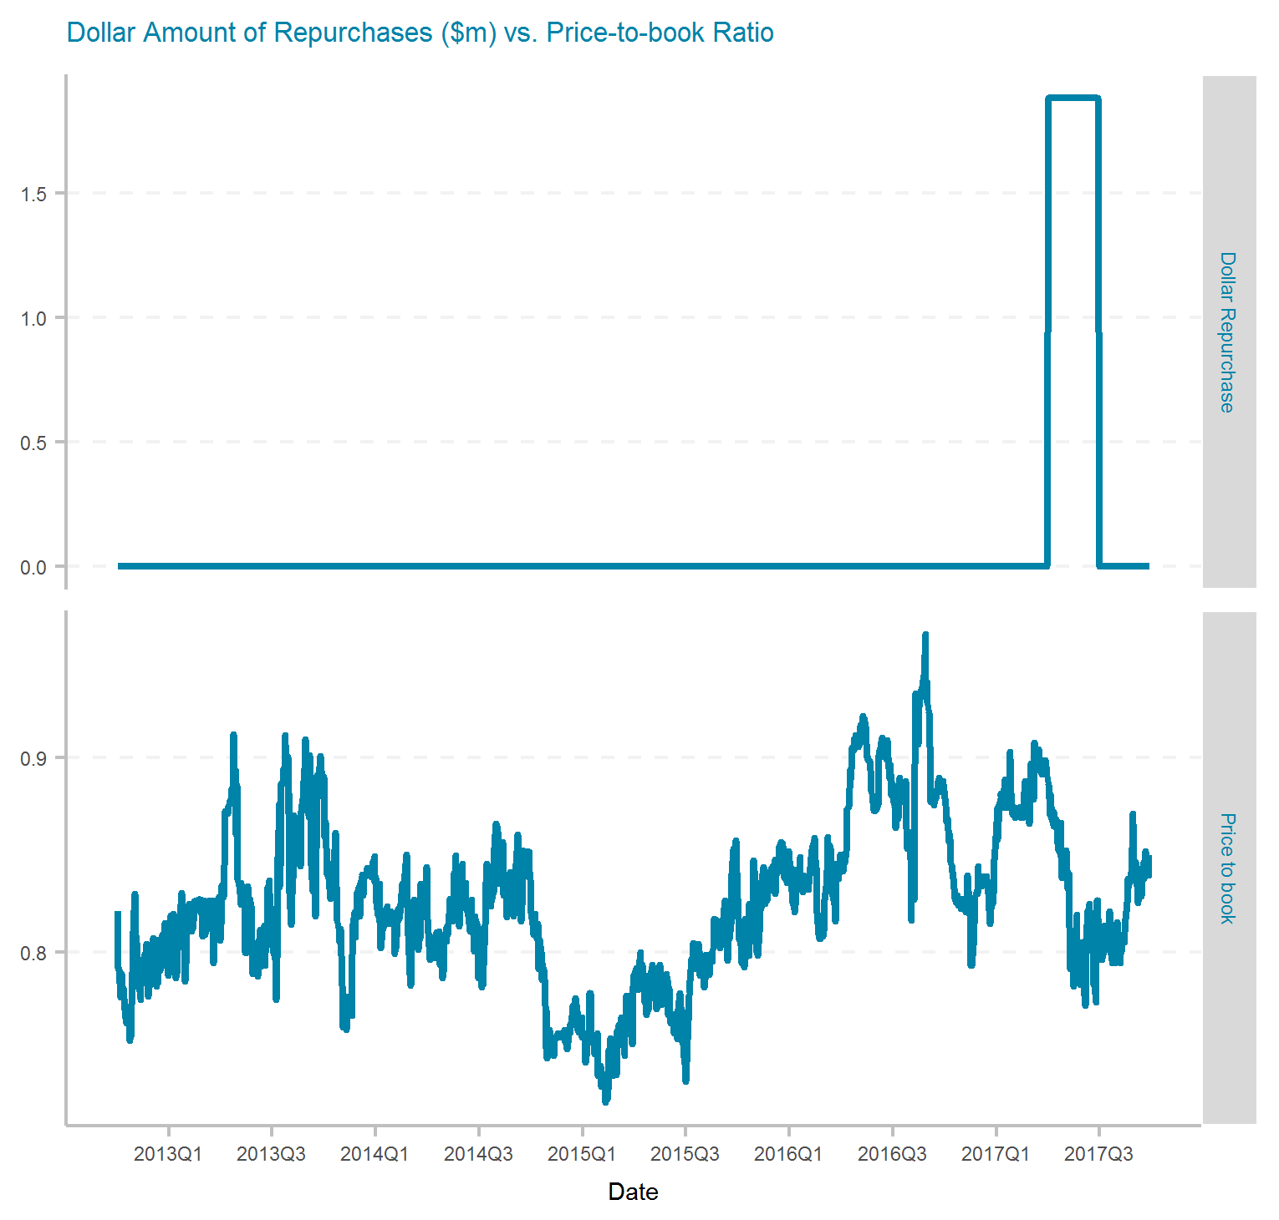
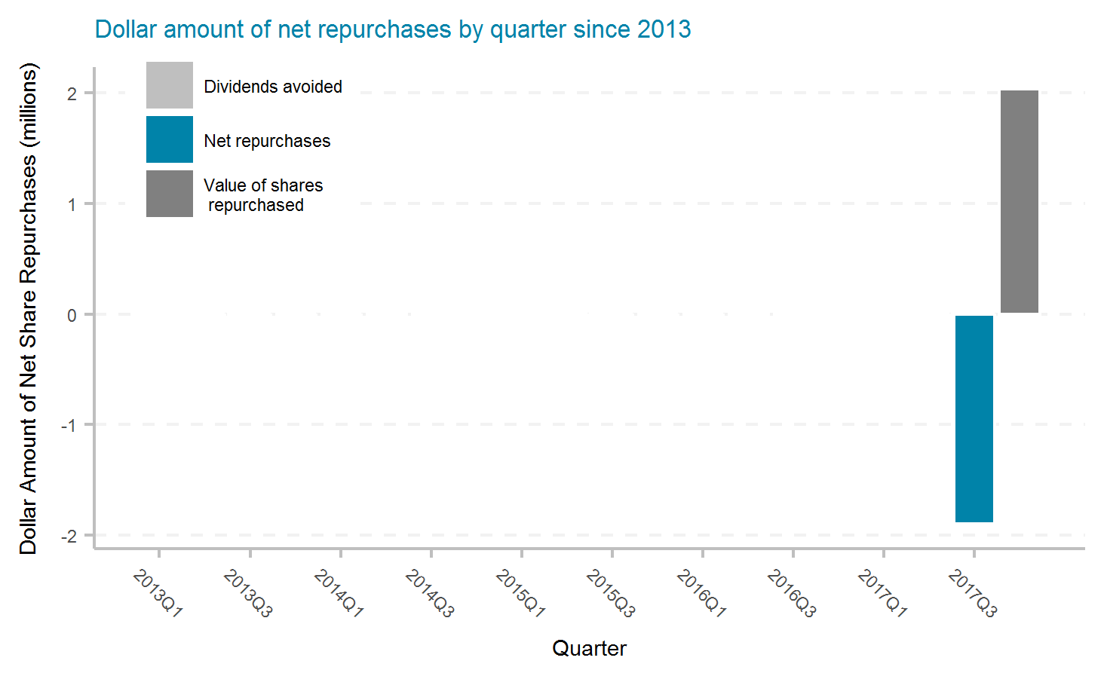
Baldwin & Lyons, Inc.
Ticker | # of quarters | Current Mkt Cap ($m) | Initial Shares (mil) | Shares Repurchased (mil) | Dollar Repurchased ($m) | Percent of Initial Shares Repurchased | Percent of Mkt Cap Repurchased | Total Shareholder Return | Buyback ROI | Buyback Effectiveness

Slide 20
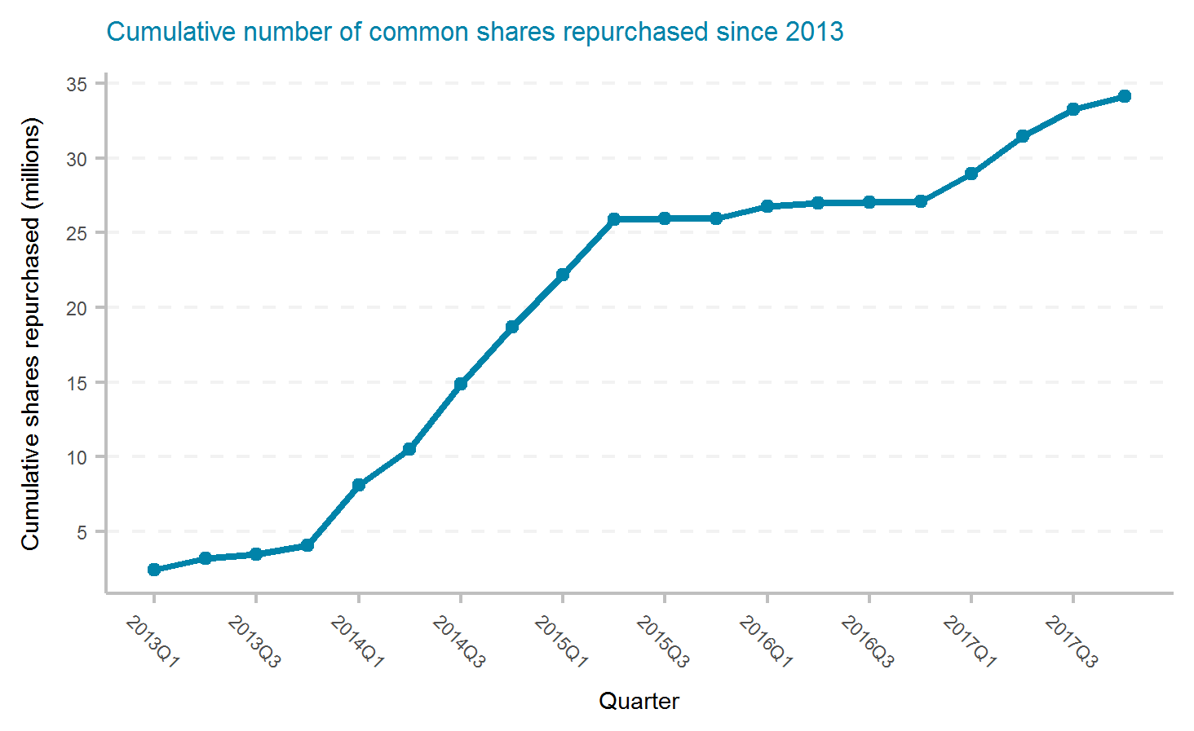
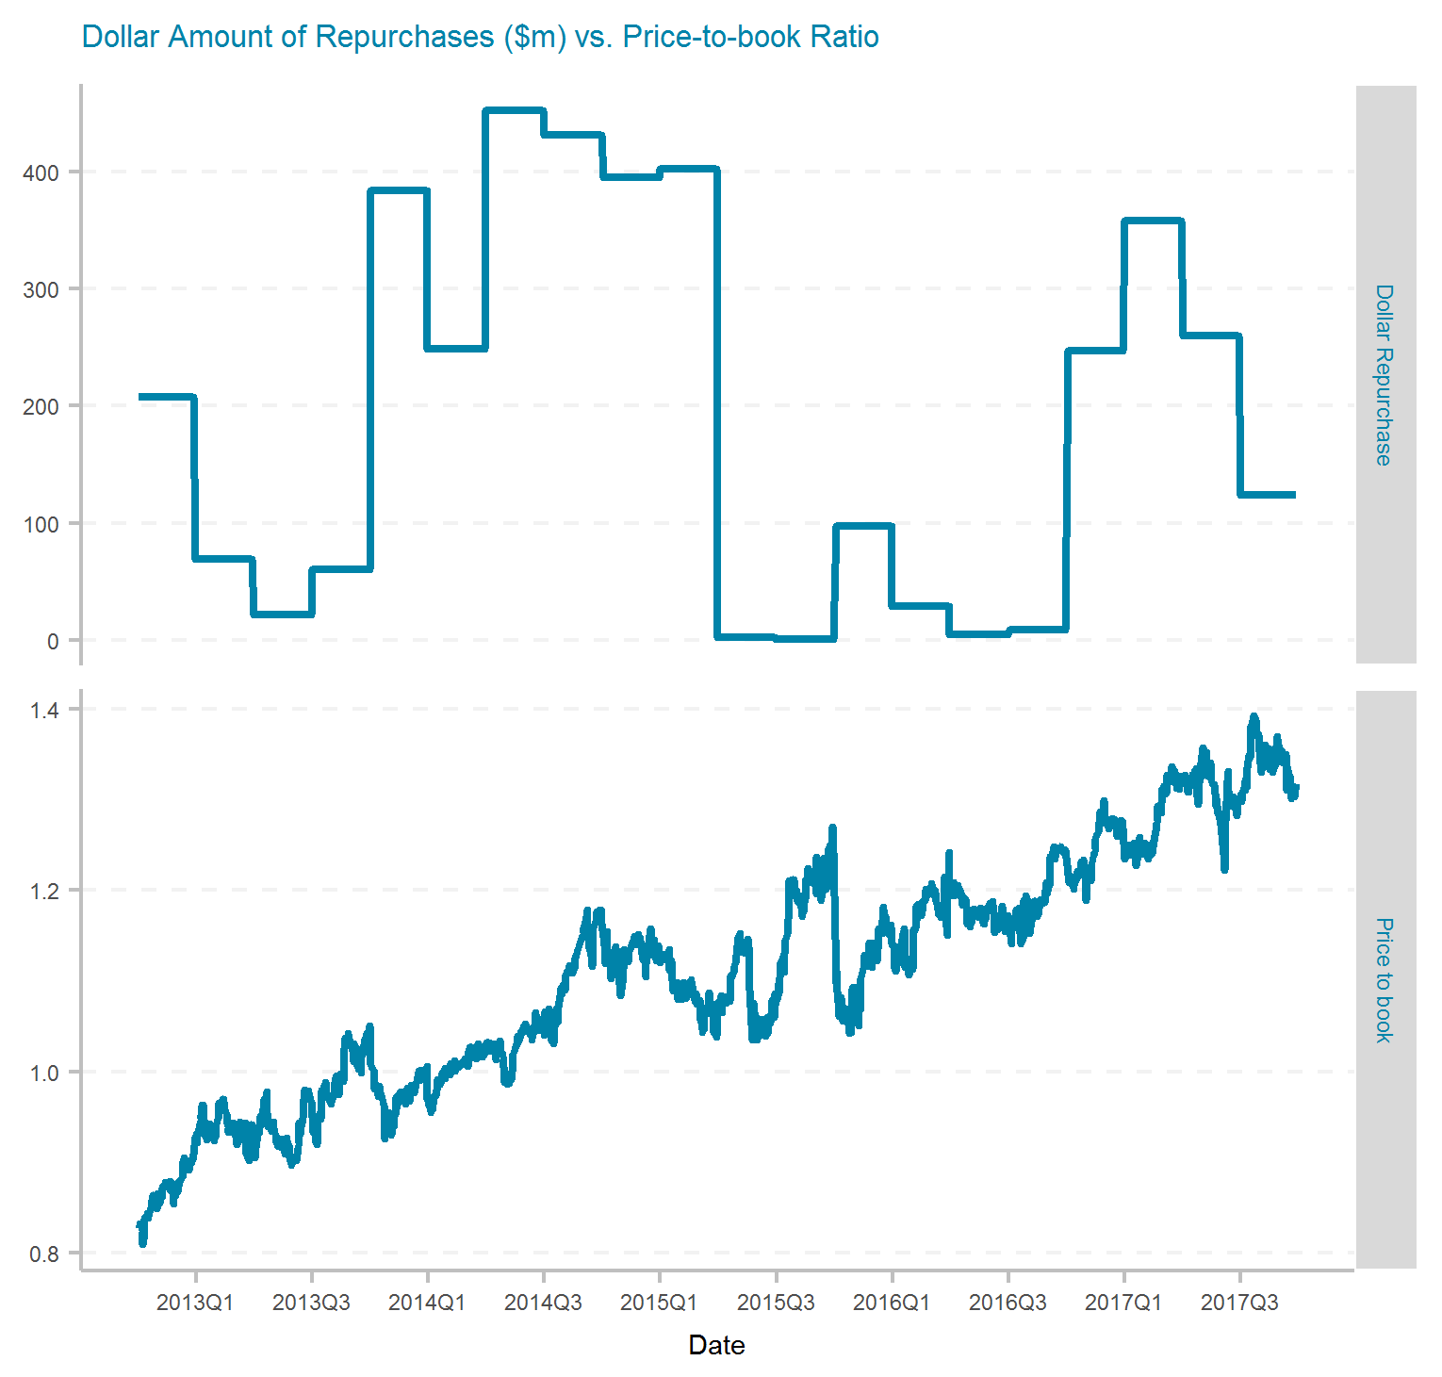
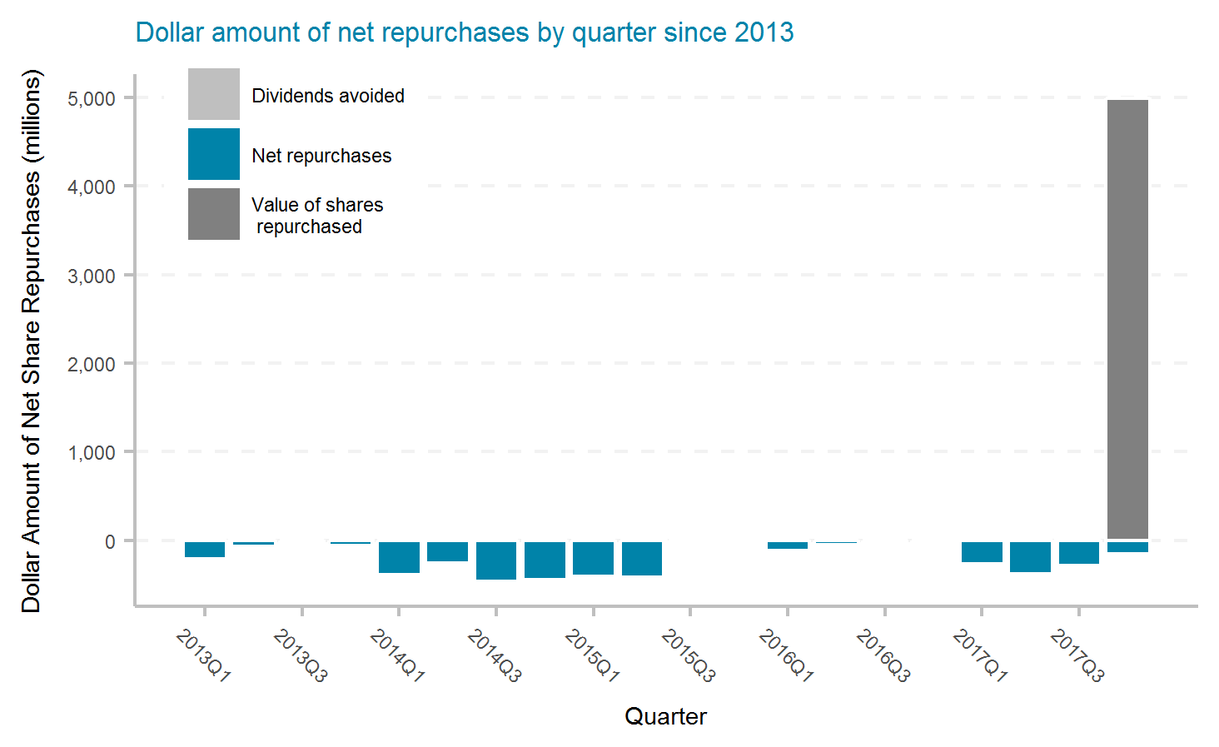
Chubb Limited
Ticker | # of quarters | Current Mkt Cap ($m) | Initial Shares (mil) | Shares Repurchased (mil) | Dollar Repurchased ($m) | Percent of Initial Shares Repurchased | Percent of Mkt Cap Repurchased | Total Shareholder Return | Buyback ROI | Buyback Effectiveness
CB | 20 | 63,200 | 340.0 | 34.1 | 3,800 | 10.0% | 6.0% | 12.0% | 13.8% | 1.6%

Slide 21
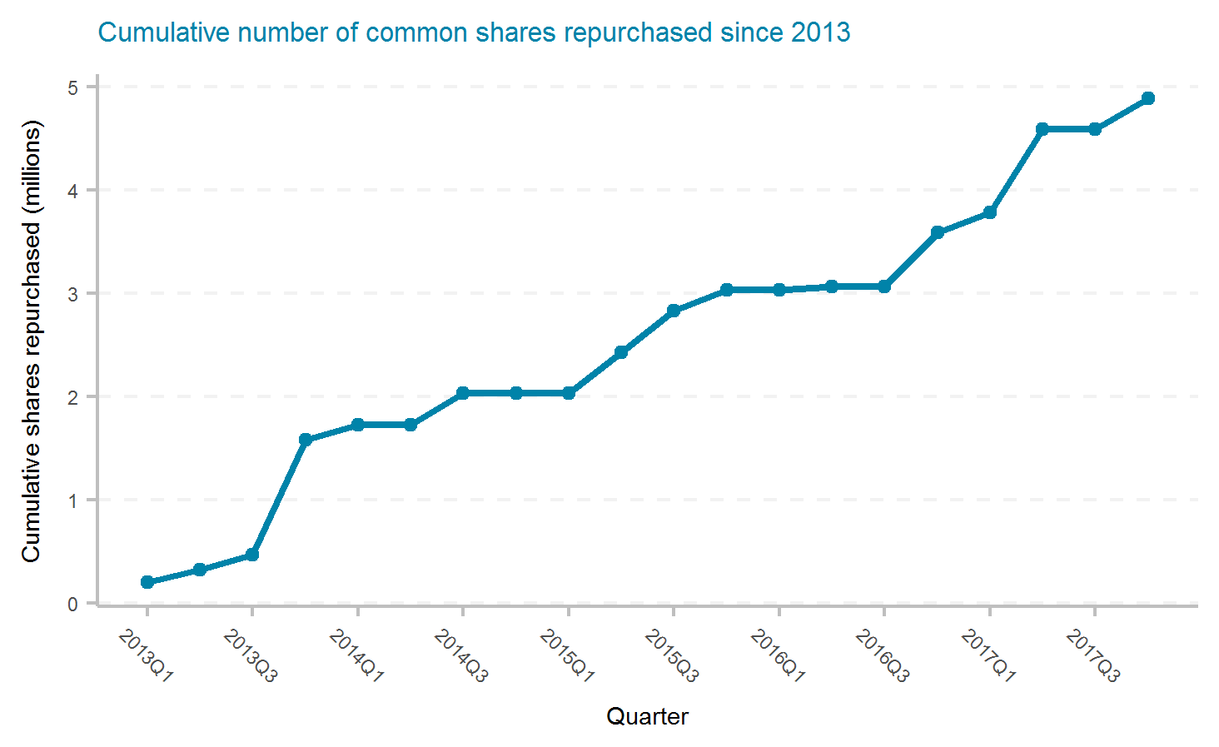
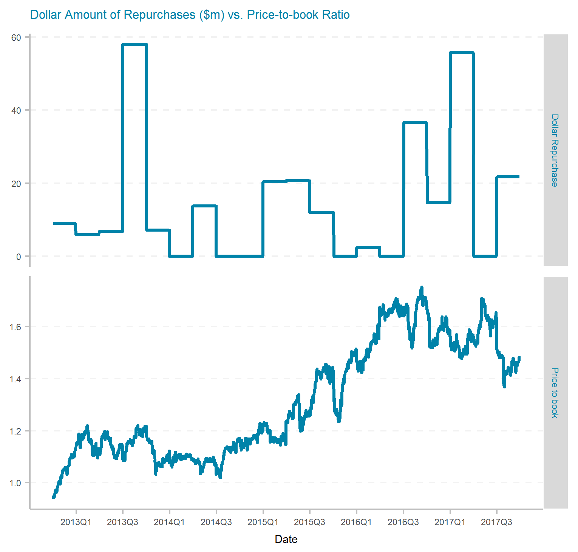
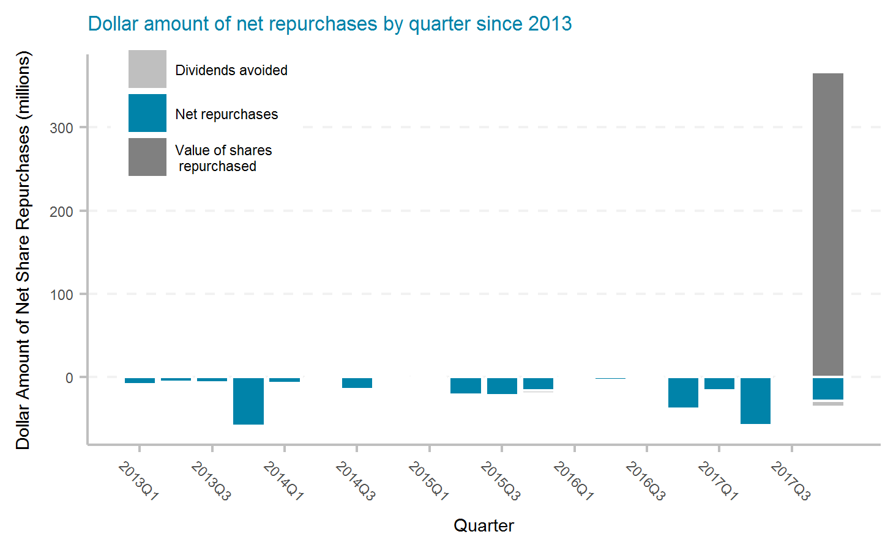
Cincinnati Financial Corporation
Ticker | # of quarters | Current Mkt Cap ($m) | Initial Shares (mil) | Shares Repurchased (mil) | Dollar Repurchased ($m) | Percent of Initial Shares Repurchased | Percent of Mkt Cap Repurchased | Total Shareholder Return | Buyback ROI | Buyback Effectiveness
CINF | 20 | 11,550 | 163.0 | 4.9 | 285 | 3.0% | 2.5% | 12.8% | 16.6% | 3.4%

Slide 22
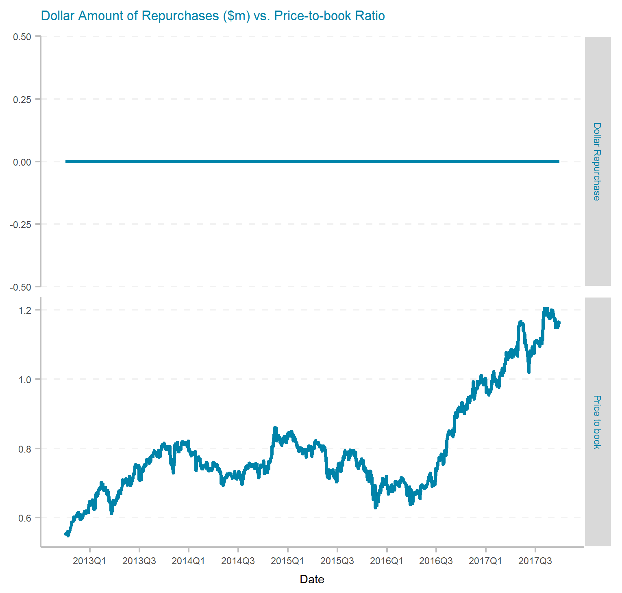
CNA Financial Corporation
Ticker | # of quarters | Current Mkt Cap ($m) | Initial Shares (mil) | Shares Repurchased (mil) | Dollar Repurchased ($m) | Percent of Initial Shares Repurchased | Percent of Mkt Cap Repurchased | Total Shareholder Return | Buyback ROI | Buyback Effectiveness

Slide 23
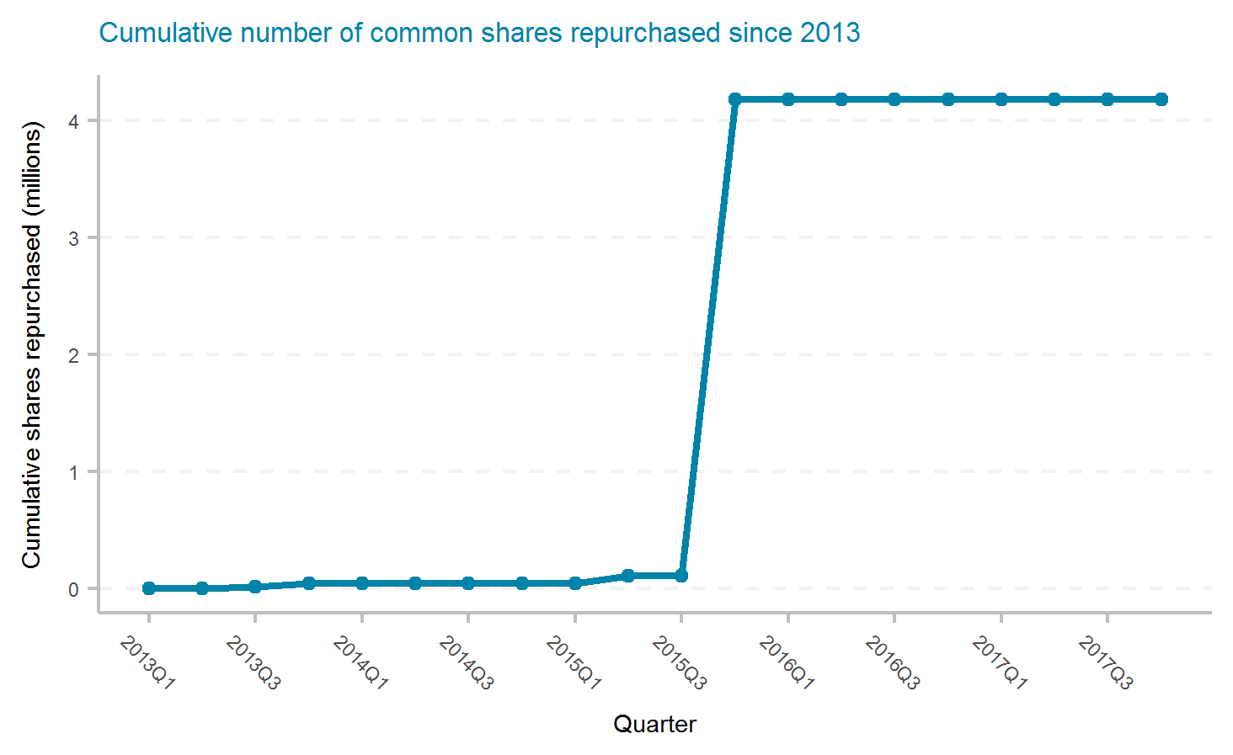
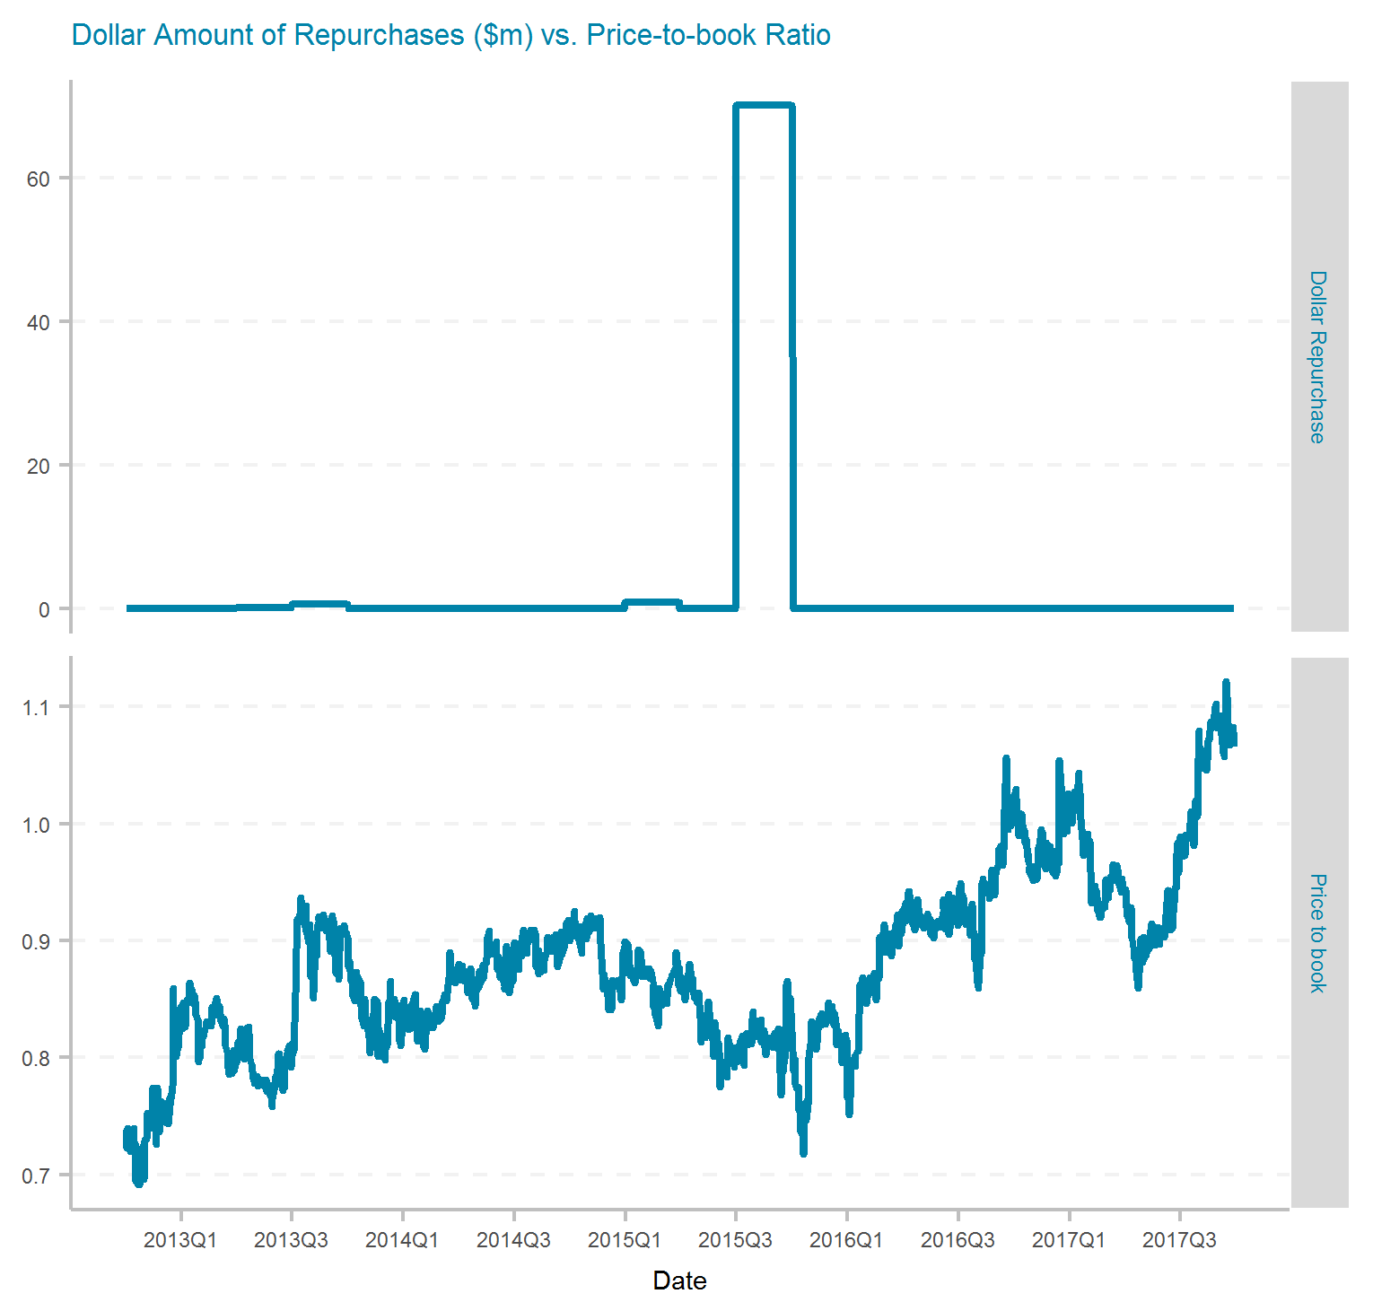
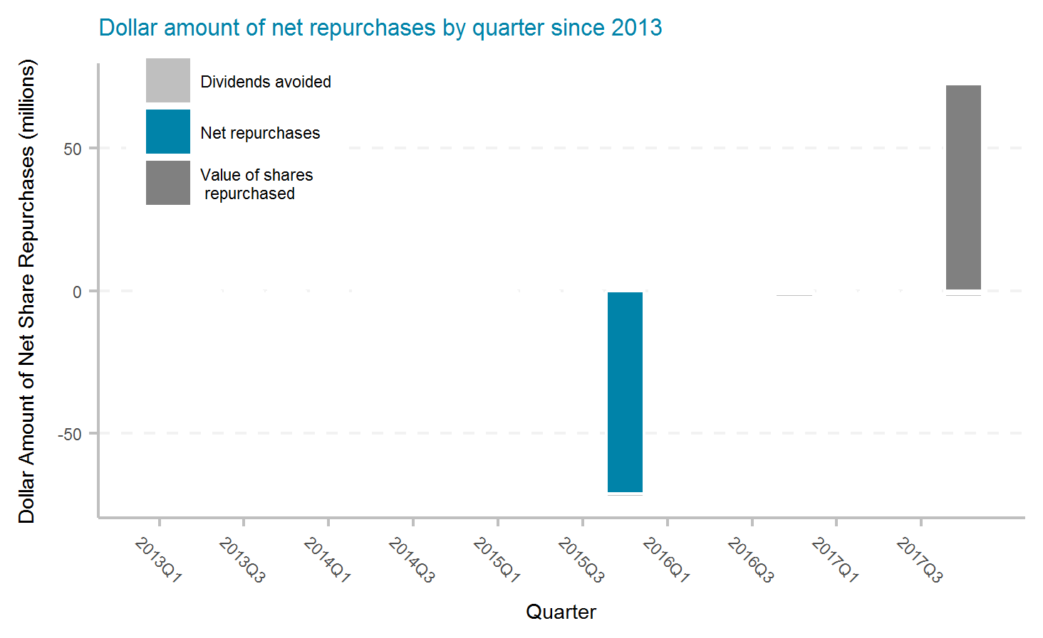
Donegal Group Inc.
Ticker | # of quarters | Current Mkt Cap ($m) | Initial Shares (mil) | Shares Repurchased (mil) | Dollar Repurchased ($m) | Percent of Initial Shares Repurchased | Percent of Mkt Cap Repurchased | Total Shareholder Return | Buyback ROI | Buyback Effectiveness
DGICA | 20 | 393 | 25.8 | 4.2 | 72 | 16.2% | 18.3% | 5.4% | 4.5% | -0.9%

Slide 24
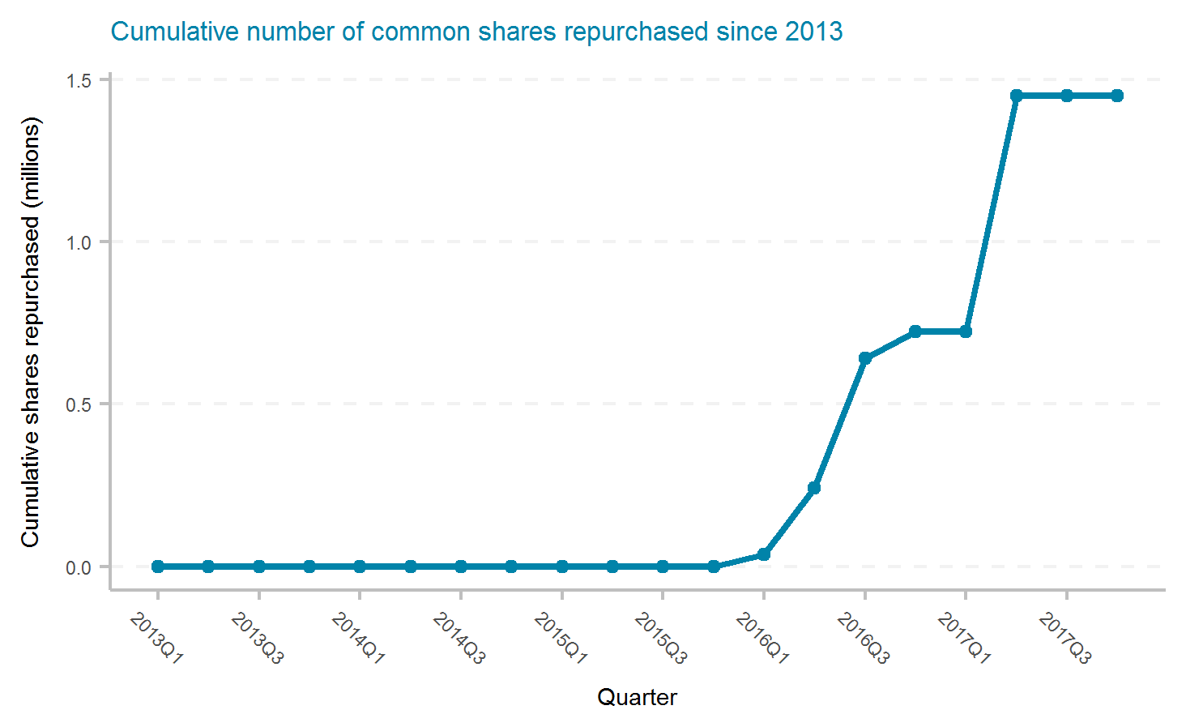
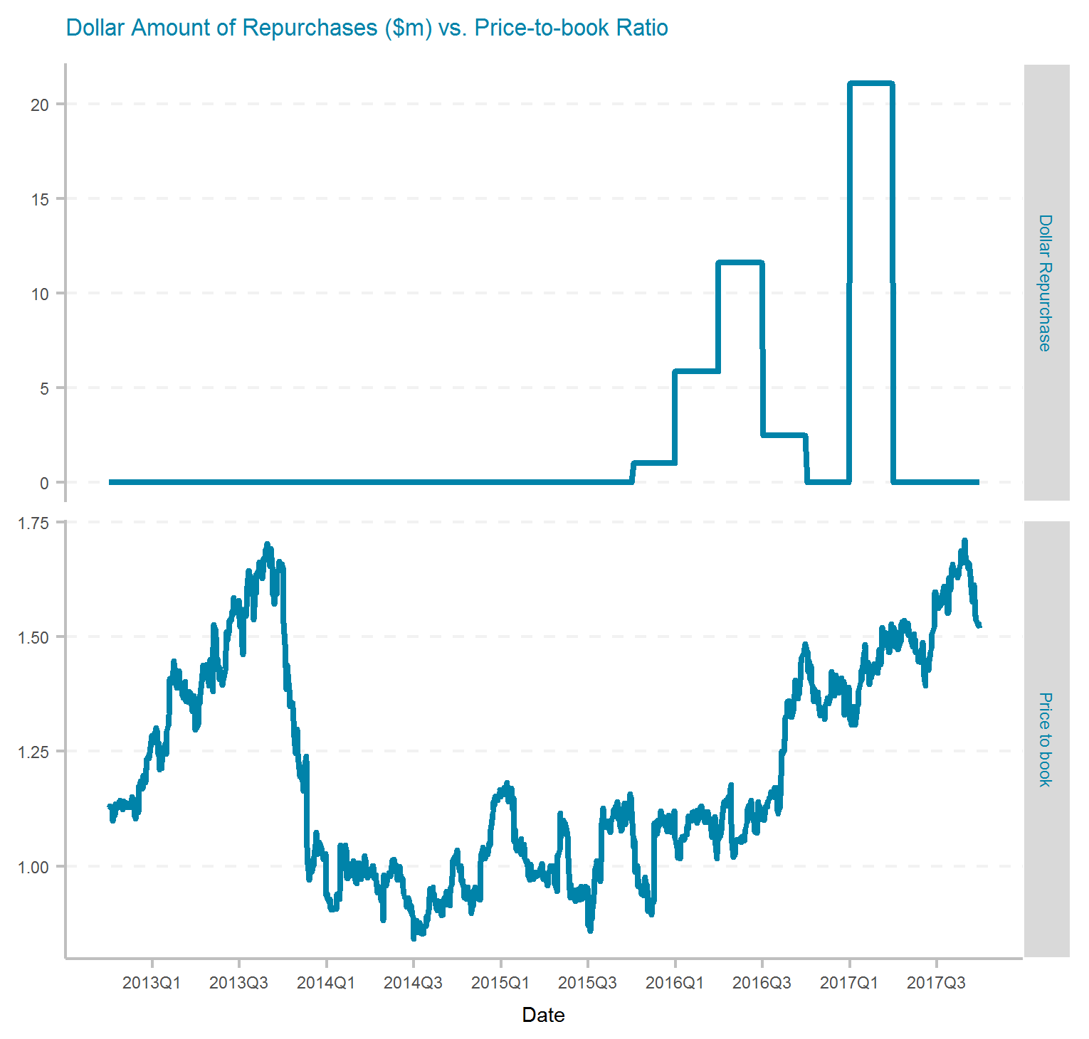
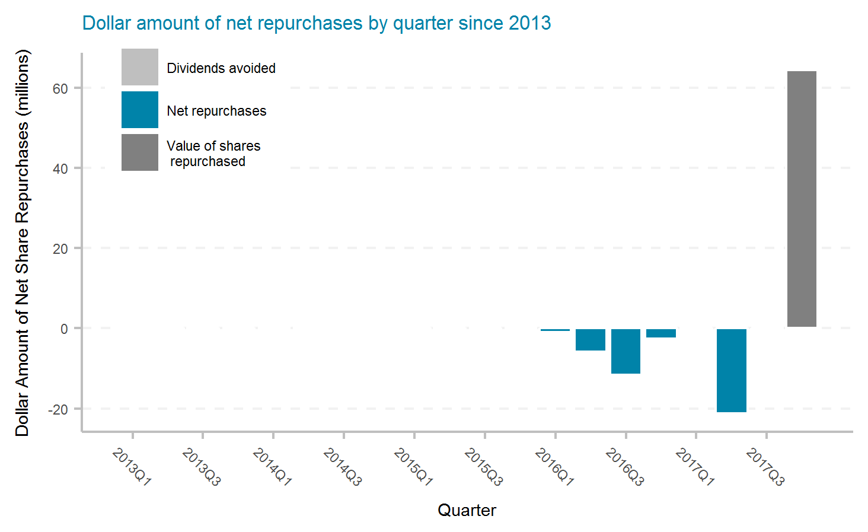
Employers Holdings, Inc.
Ticker | # of quarters | Current Mkt Cap ($m) | Initial Shares (mil) | Shares Repurchased (mil) | Dollar Repurchased ($m) | Percent of Initial Shares Repurchased | Percent of Mkt Cap Repurchased | Total Shareholder Return | Buyback ROI | Buyback Effectiveness
EIG | 20 | 1,340 | 30.9 | 1.4 | 42 | 4.7% | 3.1% | 14.5% | 59.1% | 39.0%

Slide 25
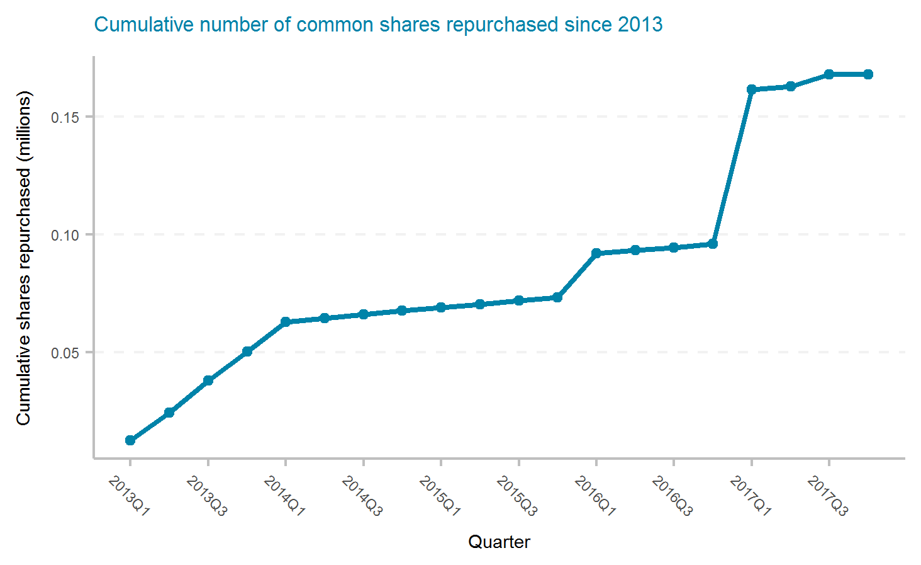


EMC Insurance Group Inc.
Ticker | # of quarters | Current Mkt Cap ($m) | Initial Shares (mil) | Shares Repurchased (mil) | Dollar Repurchased ($m) | Percent of Initial Shares Repurchased | Percent of Mkt Cap Repurchased | Total Shareholder Return | Buyback ROI | Buyback Effectiveness

Slide 26

Erie Indemnity Company
Ticker | # of quarters | Current Mkt Cap ($m) | Initial Shares (mil) | Shares Repurchased (mil) | Dollar Repurchased ($m) | Percent of Initial Shares Repurchased | Percent of Mkt Cap Repurchased | Total Shareholder Return | Buyback ROI | Buyback Effectiveness

Slide 27



Enstar Group Limited
Ticker | # of quarters | Current Mkt Cap ($m) | Initial Shares (mil) | Shares Repurchased (mil) | Dollar Repurchased ($m) | Percent of Initial Shares Repurchased | Percent of Mkt Cap Repurchased | Total Shareholder Return | Buyback ROI | Buyback Effectiveness

Slide 28



Federated National Holding Company
Ticker | # of quarters | Current Mkt Cap ($m) | Initial Shares (mil) | Shares Repurchased (mil) | Dollar Repurchased ($m) | Percent of Initial Shares Repurchased | Percent of Mkt Cap Repurchased | Total Shareholder Return | Buyback ROI | Buyback Effectiveness
FNHC | 20 | 222 | 8.0 | 1.3 | 24 | 16.0% | 10.6% | 18.3% | -9.8% | -23.7%

Slide 29



Greenlight Capital Re, Ltd.
Ticker | # of quarters | Current Mkt Cap ($m) | Initial Shares (mil) | Shares Repurchased (mil) | Dollar Repurchased ($m) | Percent of Initial Shares Repurchased | Percent of Mkt Cap Repurchased | Total Shareholder Return | Buyback ROI | Buyback Effectiveness
GLRE | 20 | 579 | 36.8 | 0.7 | 21 | 2.0% | 3.5% | -3.8% | -14.1% | -10.7%

Slide 30



Hallmark Financial Services, Inc.
Ticker | # of quarters | Current Mkt Cap ($m) | Initial Shares (mil) | Shares Repurchased (mil) | Dollar Repurchased ($m) | Percent of Initial Shares Repurchased | Percent of Mkt Cap Repurchased | Total Shareholder Return | Buyback ROI | Buyback Effectiveness
HALL | 20 | 187 | 19.3 | 1.4 | 16 | 7.5% | 8.4% | 3.0% | -2.8% | -5.7%

Slide 31



HCI Group, Inc.
Ticker | # of quarters | Current Mkt Cap ($m) | Initial Shares (mil) | Shares Repurchased (mil) | Dollar Repurchased ($m) | Percent of Initial Shares Repurchased | Percent of Mkt Cap Repurchased | Total Shareholder Return | Buyback ROI | Buyback Effectiveness
HCI | 20 | 396 | 10.9 | 3.2 | 129 | 29.7% | 32.6% | 6.1% | -8.3% | -13.5%

Slide 32



Hartford Financial Services Group, Inc.
Ticker | # of quarters | Current Mkt Cap ($m) | Initial Shares (mil) | Shares Repurchased (mil) | Dollar Repurchased ($m) | Percent of Initial Shares Repurchased | Percent of Mkt Cap Repurchased | Total Shareholder Return | Buyback ROI | Buyback Effectiveness
HIG | 20 | 19,280 | 435.3 | 149.3 | 6,010 | 34.3% | 31.2% | 18.6% | 17.3% | -1.1%

Slide 33



Horace Mann Educators Corporation
Ticker | # of quarters | Current Mkt Cap ($m) | Initial Shares (mil) | Shares Repurchased (mil) | Dollar Repurchased ($m) | Percent of Initial Shares Repurchased | Percent of Mkt Cap Repurchased | Total Shareholder Return | Buyback ROI | Buyback Effectiveness
HMN | 20 | 1,830 | 39.7 | 1.8 | 54 | 4.5% | 3.0% | 18.6% | 20.9% | 1.9%

Slide 34



Heritage Insurance Holdings, Inc.
Ticker | # of quarters | Current Mkt Cap ($m) | Initial Shares (mil) | Shares Repurchased (mil) | Dollar Repurchased ($m) | Percent of Initial Shares Repurchased | Percent of Mkt Cap Repurchased | Total Shareholder Return | Buyback ROI | Buyback Effectiveness
HRTG | 15 | 417 | 29.8 | 7.1 | 88 | 23.8% | 21.1% | 5.5% | 70.7% | 61.8%

Slide 35



Infinity Property and Casualty Corporation
Ticker | # of quarters | Current Mkt Cap ($m) | Initial Shares (mil) | Shares Repurchased (mil) | Dollar Repurchased ($m) | Percent of Initial Shares Repurchased | Percent of Mkt Cap Repurchased | Total Shareholder Return | Buyback ROI | Buyback Effectiveness
IPCC | 20 | 1,440 | 11.6 | 1.0 | 79 | 9.0% | 5.5% | 15.4% | 17.9% | 2.1%

Slide 36



James River Group Holdings, Ltd.
Ticker | # of quarters | Current Mkt Cap ($m) | Initial Shares (mil) | Shares Repurchased (mil) | Dollar Repurchased ($m) | Percent of Initial Shares Repurchased | Percent of Mkt Cap Repurchased | Total Shareholder Return | Buyback ROI | Buyback Effectiveness

Slide 37



Kingsway Financial Services Inc.
Ticker | # of quarters | Current Mkt Cap ($m) | Initial Shares (mil) | Shares Repurchased (mil) | Dollar Repurchased ($m) | Percent of Initial Shares Repurchased | Percent of Mkt Cap Repurchased | Total Shareholder Return | Buyback ROI | Buyback Effectiveness

Slide 38



Kingstone Companies, Inc.
Ticker | # of quarters | Current Mkt Cap ($m) | Initial Shares (mil) | Shares Repurchased (mil) | Dollar Repurchased ($m) | Percent of Initial Shares Repurchased | Percent of Mkt Cap Repurchased | Total Shareholder Return | Buyback ROI | Buyback Effectiveness
KINS | 20 | 183 | 3.8 | 0.1 | 1 | 3.5% | 0.6% | 28.1% | 43.3% | 11.9%

Slide 39



Kemper Corporation
Ticker | # of quarters | Current Mkt Cap ($m) | Initial Shares (mil) | Shares Repurchased (mil) | Dollar Repurchased ($m) | Percent of Initial Shares Repurchased | Percent of Mkt Cap Repurchased | Total Shareholder Return | Buyback ROI | Buyback Effectiveness
KMPR | 20 | 3,480 | 58.3 | 7.7 | 269 | 13.2% | 7.7% | 17.8% | 23.1% | 4.6%

Slide 40

Mercury General Corporation
Ticker | # of quarters | Current Mkt Cap ($m) | Initial Shares (mil) | Shares Repurchased (mil) | Dollar Repurchased ($m) | Percent of Initial Shares Repurchased | Percent of Mkt Cap Repurchased | Total Shareholder Return | Buyback ROI | Buyback Effectiveness

Slide 41



Maiden Holdings, Ltd.
Ticker | # of quarters | Current Mkt Cap ($m) | Initial Shares (mil) | Shares Repurchased (mil) | Dollar Repurchased ($m) | Percent of Initial Shares Repurchased | Percent of Mkt Cap Repurchased | Total Shareholder Return | Buyback ROI | Buyback Effectiveness
MHLD | 20 | 636 | 72.4 | 3.8 | 27 | 5.2% | 4.2% | -3.3% | -12.0% | -9.1%

Slide 42



Markel Corporation
Ticker | # of quarters | Current Mkt Cap ($m) | Initial Shares (mil) | Shares Repurchased (mil) | Dollar Repurchased ($m) | Percent of Initial Shares Repurchased | Percent of Mkt Cap Repurchased | Total Shareholder Return | Buyback ROI | Buyback Effectiveness
MKL | 20 | 15,700 | 9.6 | 0.3 | 199 | 2.7% | 1.3% | 17.7% | 21.0% | 2.7%

Slide 43

Navigators Group, Inc.
Ticker | # of quarters | Current Mkt Cap ($m) | Initial Shares (mil) | Shares Repurchased (mil) | Dollar Repurchased ($m) | Percent of Initial Shares Repurchased | Percent of Mkt Cap Repurchased | Total Shareholder Return | Buyback ROI | Buyback Effectiveness

Slide 44



National General Holdings Corporation
Ticker | # of quarters | Current Mkt Cap ($m) | Initial Shares (mil) | Shares Repurchased (mil) | Dollar Repurchased ($m) | Percent of Initial Shares Repurchased | Percent of Mkt Cap Repurchased | Total Shareholder Return | Buyback ROI | Buyback Effectiveness

Slide 45

Old Republic International Corporation
Ticker | # of quarters | Current Mkt Cap ($m) | Initial Shares (mil) | Shares Repurchased (mil) | Dollar Repurchased ($m) | Percent of Initial Shares Repurchased | Percent of Mkt Cap Repurchased | Total Shareholder Return | Buyback ROI | Buyback Effectiveness

Slide 46



Progressive Corporation
Ticker | # of quarters | Current Mkt Cap ($m) | Initial Shares (mil) | Shares Repurchased (mil) | Dollar Repurchased ($m) | Percent of Initial Shares Repurchased | Percent of Mkt Cap Repurchased | Total Shareholder Return | Buyback ROI | Buyback Effectiveness
PGR | 20 | 35,110 | 603.2 | 37.0 | 1,008 | 6.1% | 2.9% | 19.8% | 31.0% | 9.4%

Slide 47



1347 Property Insurance Holdings, Inc.
Ticker | # of quarters | Current Mkt Cap ($m) | Initial Shares (mil) | Shares Repurchased (mil) | Dollar Repurchased ($m) | Percent of Initial Shares Repurchased | Percent of Mkt Cap Repurchased | Total Shareholder Return | Buyback ROI | Buyback Effectiveness
PIH | 15 | 41 | 6.4 | 1.7 | 13 | 26.9% | 31.3% | NaN% | -2.2% | NaN%

Slide 48



ProAssurance Corporation
Ticker | # of quarters | Current Mkt Cap ($m) | Initial Shares (mil) | Shares Repurchased (mil) | Dollar Repurchased ($m) | Percent of Initial Shares Repurchased | Percent of Mkt Cap Repurchased | Total Shareholder Return | Buyback ROI | Buyback Effectiveness
PRA | 20 | 2,530 | 61.8 | 9.3 | 426 | 15.1% | 16.9% | 12.4% | 23.4% | 9.8%

Slide 49



Everest Re Group, Ltd.
Ticker | # of quarters | Current Mkt Cap ($m) | Initial Shares (mil) | Shares Repurchased (mil) | Dollar Repurchased ($m) | Percent of Initial Shares Repurchased | Percent of Mkt Cap Repurchased | Total Shareholder Return | Buyback ROI | Buyback Effectiveness
RE | 20 | 9,530 | 50.0 | 12.8 | 2,008 | 25.6% | 21.1% | 13.2% | 14.3% | 1.0%

Slide 50

RLI Corp.
Ticker | # of quarters | Current Mkt Cap ($m) | Initial Shares (mil) | Shares Repurchased (mil) | Dollar Repurchased ($m) | Percent of Initial Shares Repurchased | Percent of Mkt Cap Repurchased | Total Shareholder Return | Buyback ROI | Buyback Effectiveness

Slide 51



RenaissanceRe Holdings Ltd.
Ticker | # of quarters | Current Mkt Cap ($m) | Initial Shares (mil) | Shares Repurchased (mil) | Dollar Repurchased ($m) | Percent of Initial Shares Repurchased | Percent of Mkt Cap Repurchased | Total Shareholder Return | Buyback ROI | Buyback Effectiveness
RNR | 20 | 5,450 | 44.5 | 14.7 | 1,521 | 33.0% | 27.9% | 7.5% | 8.9% | 1.3%

Slide 52



Safety Insurance Group, Inc.
Ticker | # of quarters | Current Mkt Cap ($m) | Initial Shares (mil) | Shares Repurchased (mil) | Dollar Repurchased ($m) | Percent of Initial Shares Repurchased | Percent of Mkt Cap Repurchased | Total Shareholder Return | Buyback ROI | Buyback Effectiveness
SAFT | 20 | 1,220 | 15.4 | 0.6 | 28 | 3.6% | 2.3% | 13.8% | 18.4% | 4.0%

Slide 53



Selective Insurance Group, Inc.
Ticker | # of quarters | Current Mkt Cap ($m) | Initial Shares (mil) | Shares Repurchased (mil) | Dollar Repurchased ($m) | Percent of Initial Shares Repurchased | Percent of Mkt Cap Repurchased | Total Shareholder Return | Buyback ROI | Buyback Effectiveness
SIGI | 20 | 3,480 | 55.5 | 0.8 | 22 | 1.4% | 0.6% | 20.7% | 31.5% | 9.0%

Slide 54

State Auto Financial Corporation
Ticker | # of quarters | Current Mkt Cap ($m) | Initial Shares (mil) | Shares Repurchased (mil) | Dollar Repurchased ($m) | Percent of Initial Shares Repurchased | Percent of Mkt Cap Repurchased | Total Shareholder Return | Buyback ROI | Buyback Effectiveness

Slide 55



Hanover Insurance Group, Inc.
Ticker | # of quarters | Current Mkt Cap ($m) | Initial Shares (mil) | Shares Repurchased (mil) | Dollar Repurchased ($m) | Percent of Initial Shares Repurchased | Percent of Mkt Cap Repurchased | Total Shareholder Return | Buyback ROI | Buyback Effectiveness
THG | 20 | 4,890 | 44.0 | 6.2 | 428 | 14.0% | 8.8% | 18.6% | 21.9% | 2.7%

Slide 56



Third Point Reinsurance Ltd.
Ticker | # of quarters | Current Mkt Cap ($m) | Initial Shares (mil) | Shares Repurchased (mil) | Dollar Repurchased ($m) | Percent of Initial Shares Repurchased | Percent of Mkt Cap Repurchased | Total Shareholder Return | Buyback ROI | Buyback Effectiveness
TPRE | 18 | 1,380 | 103.9 | 3.9 | 48 | 3.8% | 3.5% | 0.2% | 26.6% | 26.3%

Slide 57



Travelers Companies, Inc.
Ticker | # of quarters | Current Mkt Cap ($m) | Initial Shares (mil) | Shares Repurchased (mil) | Dollar Repurchased ($m) | Percent of Initial Shares Repurchased | Percent of Mkt Cap Repurchased | Total Shareholder Return | Buyback ROI | Buyback Effectiveness
TRV | 20 | 35,570 | 376.4 | 128.6 | 12,929 | 34.2% | 36.3% | 12.1% | 14.8% | 2.3%

Slide 58



United Fire Group, Inc.
Ticker | # of quarters | Current Mkt Cap ($m) | Initial Shares (mil) | Shares Repurchased (mil) | Dollar Repurchased ($m) | Percent of Initial Shares Repurchased | Percent of Mkt Cap Repurchased | Total Shareholder Return | Buyback ROI | Buyback Effectiveness
UFCS | 20 | 1,250 | 25.3 | 1.4 | 51 | 5.5% | 4.0% | 14.5% | 18.8% | 3.8%

Slide 59

United Insurance Holdings Corp.
Ticker | # of quarters | Current Mkt Cap ($m) | Initial Shares (mil) | Shares Repurchased (mil) | Dollar Repurchased ($m) | Percent of Initial Shares Repurchased | Percent of Mkt Cap Repurchased | Total Shareholder Return | Buyback ROI | Buyback Effectiveness

Slide 60



Universal Insurance Holdings, Inc.
Ticker | # of quarters | Current Mkt Cap ($m) | Initial Shares (mil) | Shares Repurchased (mil) | Dollar Repurchased ($m) | Percent of Initial Shares Repurchased | Percent of Mkt Cap Repurchased | Total Shareholder Return | Buyback ROI | Buyback Effectiveness
UVE | 20 | 1,140 | 40.7 | 12.4 | 113 | 30.5% | 9.9% | 45.1% | 50.4% | 3.7%

Slide 61



Validus Holdings, Ltd.
Ticker | # of quarters | Current Mkt Cap ($m) | Initial Shares (mil) | Shares Repurchased (mil) | Dollar Repurchased ($m) | Percent of Initial Shares Repurchased | Percent of Mkt Cap Repurchased | Total Shareholder Return | Buyback ROI | Buyback Effectiveness
VR | 20 | 5,380 | 106.3 | 37.9 | 1,524 | 35.7% | 28.3% | 9.7% | 8.7% | -0.9%

Slide 62



W. R. Berkley Corporation
Ticker | # of quarters | Current Mkt Cap ($m) | Initial Shares (mil) | Shares Repurchased (mil) | Dollar Repurchased ($m) | Percent of Initial Shares Repurchased | Percent of Mkt Cap Repurchased | Total Shareholder Return | Buyback ROI | Buyback Effectiveness
WRB | 20 | 9,420 | 136.0 | 17.4 | 809 | 12.8% | 8.6% | 12.6% | 19.9% | 6.6%

Slide 63



White Mountains Insurance Group, Ltd.
Ticker | # of quarters | Current Mkt Cap ($m) | Initial Shares (mil) | Shares Repurchased (mil) | Dollar Repurchased ($m) | Percent of Initial Shares Repurchased | Percent of Mkt Cap Repurchased | Total Shareholder Return | Buyback ROI | Buyback Effectiveness
WTM | 20 | 3,250 | 6.2 | 2.7 | 2,110 | 43.5% | 64.9% | 8.7% | 6.0% | -2.5%

Slide 64



XL Group Ltd
Ticker | # of quarters | Current Mkt Cap ($m) | Initial Shares (mil) | Shares Repurchased (mil) | Dollar Repurchased ($m) | Percent of Initial Shares Repurchased | Percent of Mkt Cap Repurchased | Total Shareholder Return | Buyback ROI | Buyback Effectiveness
XL | 20 | 14,330 | 291.8 | 103.8 | 3,567 | 35.6% | 24.9% | 5.2% | 3.6% | -1.5%

Slide 65



Alleghany Corporation
Ticker | # of quarters | Current Mkt Cap ($m) | Initial Shares (mil) | Shares Repurchased (mil) | Dollar Repurchased ($m) | Percent of Initial Shares Repurchased | Percent of Mkt Cap Repurchased | Total Shareholder Return | Buyback ROI | Buyback Effectiveness
Y | 20 | 8,850 | 16.8 | 1.5 | 669 | 9.2% | 7.6% | 8.5% | 11.7% | 2.9%

